Slide 1
Stage 2 Activating Identities and Futures: Modified
The SACE branded content in this presentation are all publicly available on the SACE website under AIF and EIF resources. This is a small essentials sample of this material.
Notes:
Before we end, some additional information around AIF: Modified

Slide 2


Enrolment implications
“Access to modified subjects is intended for the small number of students with significant disabilities whose learning needs cannot be met through differentiation and reasonable adjustments in curriculum and/or assessment in SACE subjects under the Board’s Special Provisions in Curriculum and Assessment Policy.” (SACE Modified Subjects Policy https://www.sace.sa.edu.au/web/modified-subjects/policies )
'This student has fulfilled the requirements of this
qualification using one or more modified subjects.’
Notes:
In determining the appropriate pathway schools should consider the best interests of the student and the likely use of Modified Subjects in each individual pathway. When a student completes a Modified Subject it is indicated on the SACE Certificate. There is no such thing as a modified SACE just a SACE certificate with modified subjects in it.

Slide 3
NCCD and SACE Flexibilities Framework
Levels of Adjustment
NCCD Levels of Adjustment | Support provided within Quality Differentiated Teaching Practices (QDTP) | Supplementary Adjustments | Substantial Adjustments | Extensive Adjustments
SACE Flexibilities Framework | Quality Differentiation through Flexible Subject options and Reasonable Adjustments Special Provisions | Quality Differentiation through Flexible Subject options and Reasonable Adjustments Special Provisions | Quality Differentiation through Flexible Subject options and Reasonable Adjustments Special Provisions Modified Subjects | Quality Differentiation through Flexible Subject options and Reasonable Adjustments Special Provisions Modified Subjects
Notes:
It is important to note that Reasonable Adjustments are available to all students
The Disability Standards for Education requires adjustments to be made to ensure access to curriculum.
Students with diverse abilities who require adjustments can access these without necessarily being eligible for Modified Subjects.
Notice that Modified Subjects are only available in the Substantial and Extensive adjustment category, but adjustments are still available to students in the standard inclusive AIF subject.

Slide 4
What does the student WANT to do?
What motivates the student to learn?
ACTIVATING
IDENTITIES
FUTURES
WHO is this student?
What makes them happy, fulfilled and connected?
What does the student NEED for their future?
How will developing Agency help?
STUDENT AT THE CENTRE OF AIF

Slide 5
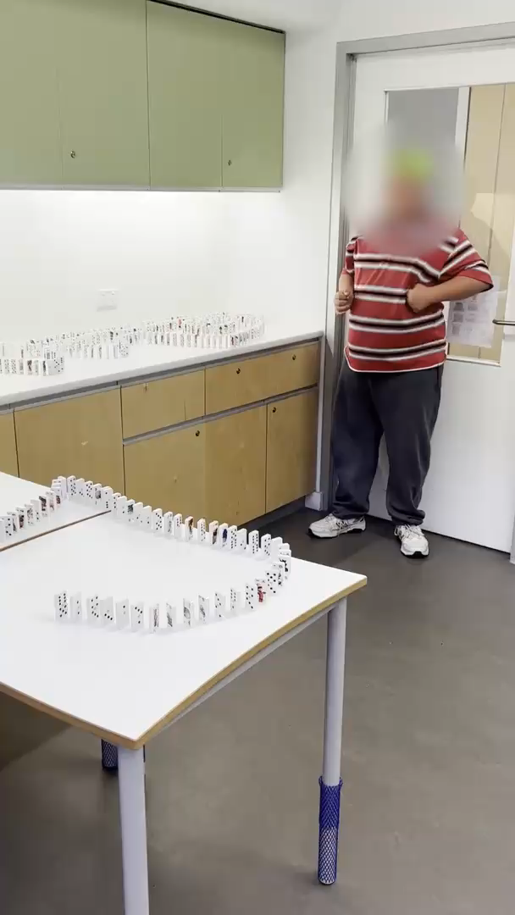
Natural Evidence of Learning in EIF Modified
‘Exploring Identities and Futures promotes the use of natural evidence of learning to allow students to authentically capture their experiences.”
Subject Outline
Part A: EXPLORING ME AND WHO I WANT TO BE
Part B: TAKING ACTION AND SHOWCASING MY CAPABILITIES
Notes:
Annalisa
Video (with sound on) is an example of NEoL – Human Connection and Belonging and Zest for life

Slide 6
Stage 1 EIF
Emerging self-regulation I am in control
Stage 1 EIF Modified
Emerging agency I can choose
Developing self-efficacy I believe I can do it
Developing communication
I can think about my learning and tell others what I have learnt
Developing self-efficacy I believe I can do it
Developing communication
I can communicate to show my learning the way I prefer
Emerging co-regulation I can access the help I need
Emerging agency I can choose
EIF and EIF Modified
links
Notes:
Annalisa
Development and growth in EIF Modified is relevant to EIF and to AIF Modified in the future.

Slide 7
Stage 2 AIF
Refining self-regulation I can work out how to do it
Stage 2 AIF Modified
Further developing agency My choices are important
Exploring Metacognition I can use how I think to achieve my goals
Practicing Reflective Practice and Evaluative Judgement
I know and can justify my why
Exploring future capabilities I can build skills and connections to the world
Developing communication
I can communicate to show my learning the way I prefer
Practicing co-regulation and developing independence
I can access help and help myself
Activating agency I can choose and pursue an individual path
AIF and AIF Modified
links
Notes:
There is a clear connection between AIF and AIF Modified, as shown through the links here. This framing was also co-developed with teachers from a range of modified settings, to ensure that there is inclusivity for all students.
[read slide]
For those who have had experience with a SACE modified subject previously, there is innovation in the way that AIF Modified can be implemented. We learnt from our pilot teachers that those who only access modified options for compulsory subjects, such as RP Modified, these students were able to achieve a C- or higher in AIF. However there was still a need identified for a separate AIF Modified Option.
As such , innovation for AIF required a pivot away from the typical model of valuing goal setting and task completion in modified subjects, to focusing on achieving learning for a purpose, and utilising natural evidence of learning for assessment.
This means students can start in AIF, and move from AIF or AIF modified depending on what support they need to succeed.

Slide 8
AIF Modified Part A: Portfolio
AIF MODIFIED
PART
In Part A: Portfolio, students:
Explore ideas related to a learning goal of personal interest
Collect evidence of learning that takes place in a student learning portfolio
Explore their agency, future capabilities and/or connections with others based on at least one of the Key Areas.
A
Learning goals may be based on:
- purposeful development of a skill​
- interest exploration or enrichment​
- independence or agency enabling activity​
- transition to future connections beyond school.
Key Area 1:
Exploring and Developing Agency
Key Area 2:
Exploring Futures and Connections
Key Area 3:
Developing Capabilities
Key Area 4:
Planning and Implementing Action
With assistance, students choose a learning goal, within their proximal achievement, designed to further increase their agency and/or future capabilities and/or connections with others.
Assessed holistically with Part B
NEoL With
Annotations
Notes:
As such, AIF Modified has been designed with two key parts, in which students show learning to address both parts. Students develop a learning goal, which may be based on but not limited to [read brackets and box on slide].
In Part A: Portfolio, students show their evidence of learning as they work towards their learning goal.
There are still ‘Key Areas’ available, as per the AIF Modified Subject Outline, that can be used in conjunction with their Learning Goal.

Slide 9
AIF Modified Part B: Showcasing Learning
AIF MODIFIED
PART
For assessment, students present 3-5 samples of natural evidence of learning, collectively demonstrating achievement of the three assessment design criteria
B
In Part B, students select and showcase natural evidence of learning that best demonstrate their progress towards their learning goal.
With assistance, students engage in activities to reflect on and communicate the value and purpose of their learning, based on Key Learning Area 5:
Exploring Agency and/or futures and/or connections
AIF1 Student further explores agency and/or futures and/or connections with others
Planning and Implementing Action
AIF2 Student further engages with learning activities for a purpose
Communicating Evidence of Learning
AIF3 Student communicates evidence of learning in an authentic and personally relevant manner
Key Learning Area 5
reflect on and communicate the value and purpose of the learning for themselves and/or others
showcase how their evidence represents purposeful development or progress in their learning.
Assessed holistically with Part A
NEoL With
Annotations
Notes:
In Part B,[read slide ]
Key area 5:
Reflecting on learning experiences
Identifying growth and/or progress in learning
Recounting and/or demonstrating learning to an audience
For assessment, [read brackets].
Brief annotations, explaining how each piece of evidence represents the achievement of learning for a purpose, should accompany student samples of natural evidence of learning.
Your school will only be required to submit materials for Modified Review if your site is due for Modified Subject Review. If so, you supply the Stage 2 AIF: modified – Natural Evidence of Learning Assessment Record

Slide 10
Evidence of learning – “completed”
Completed
Teacher assigns result of “completed” based on evidence of authentic learning progress for a purpose
Not completed
Where there is insufficient evidence of authentic learning progress, students should be withdrawn or given additional time
Learning progress must be of an appropriate proximal achievement for the individual student
The teacher should assign a result of ‘not completed’ if learning is not scheduled to continue
Exploring Agency and/or futures and/or connections
AIF1 Student further explores agency and/or futures and/or connections with others
Planning and Implementing Action
AIF2 Student further engages with learning activities for a purpose
Communicating Evidence of Learning
AIF3 Student communicates evidence of learning in an authentic and personally relevant manner
Notes:
A point of difference between SACE Modified subjects and AIF Modified is what we mean by the term completed. Typically, when we refer to “completed” it means the goal has been completed, but in AIF the learning is about the progress not completing the goal. As such, the teacher assigns a result of ‘completed’ or ‘not completed’ for AIF: Modified based on evidence of authentic learning progress for a purpose aligned with the three specific features of the assessment criteria.
Learning progress must be of an appropriate proximal achievement for the individual student.
Where there is insufficient evidence of authentic learning progress, students should be withdrawn and given additional time to make the progress required. The teacher should assign a result of ‘not completed’ if learning is not scheduled to continue.
*The learning goal does not need to be completed to result, to result as completed the student shows evidence of progress for a purpose.

Slide 11
AIF: Modified
Learning from the pilot showed us there may be a ‘pivot point’:
A student may start in AIF and move to AIF: Modified
A student may start in AIF: Modified and move to AIF
Student does not pivot and results in the subject as initiated
Schools know their students best and, as such, are best placed to identify and implement reasonable adjustments for students with disability. Schools are responsible for recording decisions about eligibility for modified subjects in Schools Online. Schools can seek advice from the SACE Board to support the fair and equitable management of modified subjects’ eligibility
Notes:
Schools know their students best and, as such, are best placed to identify and implement reasonable adjustments for students with disability. Principals or their delegates are responsible for determining students’ eligibility for modified subjects in accordance with the SACE Modified Subjects Policy. Schools are responsible for recording decisions about eligibility for modified subjects in Schools Online. Schools can refer to SACE modified subjects resources on the SACE website and seek advice from the SACE Board to support the fair and equitable management of modified subjects’ eligibility
Learning from the pilot showed us there may be a ‘pivot point’ in the subject.
This means students can start in AIF, and move from AIF or AIF modified depending on what support they need to succeed.

