Slide 1

Passport
to Thrive

Slide 2


2026 ASRT Conference 14th February 2026
Notes:
Hello and welcome! Happy Valentine’s Day!
My name is Jane and I am a faculty manager at the SACE Board. I have been overseeing the implementation of AIF over the last 18 months and I am pleased to be here today to talk about how the implementation of AIF has gone, links to our Subject Renewal project and the new Quality Assurance process of Front Loaded Moderation.

Slide 3
Implementation of AIF

Slide 4

Stage 2 Review:
to investigate what secondary education should look like for current and future generation of students
Passport to Thrive
AIF Pilot 1:
>1000 students
19 schools
2020
2023
2018
2022
2024
2025
SACE strategic plan:
Thrive
Elements of Thrive
Capabilities
Pilot Projects established
AIF Pilot 2:
>4000 students
63 schools
SA/NT
All SEQs
All Sectors
Modified option
AIF available to all schools
(last year to teach RP)
Notes:
If you attended any of our AIF Implementation workshops across 2024 and 2025 then you will be familiar with this slide. It is the journey that AIF took as a subject.
It started in 2018 with a review undertaken by the SA government which provided strong direction about what senior secondary education should look like, and more importantly, how well compulsory aspects of the SACE (PLP and RP) prepared students for the life ahead of them.
In response to this review, we launched a new strategic plan in 2020. This strategic plan built on research which showed creating space to deliberately support students to develop transferrable capabilities for a world beyond school is what would best enable them to thrive.
As a result, we established the EIF, AIF, Recognition of Aboriginal Cultural Knowledge and the Capabilities & Learner Profile pilot projects.
AIF went through its first pilot in 2022 and involved more than 1000 students from 19 schools.
In 2023, more than 7500 students, drawn from a wide cross-section of the SACE community, enrolled in AIF. These students have helped us test what would best allow this subject to deliver on its promise of enabling greater student agency as a vehicle to learn about learning.
2024 heralded the SACE Board’s new strategic plan, which builds upon our findings and seeks to deliver a passport to thrive. Our vision is that students who complete the SACE will develop the skills, qualities and confidence to be able to know what do when they don’t know what to do.
In 2025 AIF became available to all schools to implement – of which over 80% of schools elected to do, resulting in either semester 1 or 2. 2025 also marked the final year of Research Project. As an RP teacher from the very beginning myself, this was a bitter sweet moment to experience. In 2026 AIF is now a compulsory subject for all schools, and Research Project is no more.
With the launch of the Passport to Thrive, the SACE Board also launched its ambitious subject renewal program where we are aiming to renew all SACE subjects over the next few years. EIF and AIF have become the flagship subjects of this new strategic plan and from the model that we are learning from. I will touch on more about subject renewal shortly.

Slide 5
Activating Identities and Futures (AIF)
AT3 Appraisal 30%
AT1 Portfolio 35%
AT2 Progress Checks 35%
Stage 2
If students have already done RP, they don’t have to do AIF as well
credits
Key Operational Information:
Teachers do not need to write a LAP
Is a Tertiary Admission Subject (SATAC approved as providing appropriate preparation for tertiary studies)
Available to all schools in SA from 2025
3 ASSESSMENT TYPES
Notes:
If you are new to AIF this may be some helpful information. Like RP, AIF is a 10 Credit subject commensurate with 1 semester of work.
One of the key findings of the 2018 review was that manageability of workload was a major issue for students. I think if you ever taught or marked or moderated RP, you will know from experience that the investment of time & effort by many students went well beyond that required of a 10 credit – 60 hour – subject.
Keeping AIF to one semester will support students to manage their SACE workload. Feedback we have received during implementation is that 1 semester is an appropriate time commitment for AIF
In AIF, there is a strong connection and interplay between the three different assessment types.
When students begin AIF they will identify a learning goal that is meaningful to them & start with developing a portfolio of natural evidence of learning as they progress towards that goal.
In the process of working towards their learning goal, they will check in with their teacher (you) - this check in, or progress check, is an opportunity for them to demonstrate to you their decision making and metacognitive skills. This is also an opportunity for you to guide, mentor and support their development as they progress.
Finally, towards the end of their learning journey, students will appraise their learning and how they went in relation to developing an output of learning in the AT3 Appraisal.
Please Note – its great to include the learning output for context, and students should draw connections to it, but this output of learning does not need to be ‘complete’.
You will notice that the three assessment types have a fairly equal distribution; this reflects the feedback from the pilots which indicated that the learning assessed in each assessment type should be valued equally.
I am not going to talk at length about what each of those assessment types requires as there are a number of experienced AIF teachers and leaders who are hear today to share their knowledge and experience with you throughout the day and I will leave the specific discussions to them..

Slide 6



Key Drivers
Time and space to go deep
Time for feedback on process and thinking
Developing capacity to initiate and progress learning
Making decision in partnership with teachers
Teacher as co-agent in learning
Deep Authentic Learning
Agency
Natural Evidence of Learning
Authentic and varied evidence
Supporting student strength and choice
Curated for self
Meta- cognition
Developing capability to think about own thinking and learning
Evaluating own processes for learning
Notes:
These Key Drivers are the force behind AIF
Central to AIF is allowing students to have the opportunity to take greater ownership and agency over their learning.
Students must have the opportunity to develop greater awareness and understanding of their own thought processes, decision making, and organisation in relation to the learning process.
If they are to have this opportunity, we cannot prescribe or dictate the way that students must show their learning, or present their evidence.
Their evidence should be relevant to the learning context & authentic for the student’s way of learning; the evidence should be ‘curated for the self’, rather than ‘created for the SACE Board’.
I thought now would be a good time to address the main questions we have received from teachers across the last 12 months of full implementation.

Slide 7
Natural Evidence of Learning
How do I assess that?
What does it look like?
What is NEoL?
Notes:
One of the most frequent quetestions we get are around Natural Evidence of Learning.
These are not easy questions to answer as it will be different for every student. This comes up throughout the year, at front loaded moderation events and also throughout final moderation at the end of each semester.

Slide 8
Natural Evidence of Learning
Self-determined rather than prescribed
Messy and unstructured to reflect the way real learning happens
Shows trial and error, failure and success
Includes varied forms of evidence
Evidence created in the moment
Shows the progression of learning
Values the process of learning in conjunction with the final task (output of learning)
Notes:
Some of the Key indicators of success when it comes to NEoL can be seen on screen here.
NEoL means evidence determined by the student, not prescribed or templated by the teacher.
NEoL is often (but not always) unstructured. As it is not prescribed, you will often see performance standards referenced throughout a portfolio rather than in prescribed locations
NEoL shows where students have tried and failed. As a teacher I found this the hardest for students to show – particularly the perfectionists who change their mind and discard everything they did before! Trial and error gives students more to discuss in their progress checks and appraisals. This is a good thing.
NEoL often includes different forms of evidence, including phontos, videos, annotations, brainstorms etc
NEoL is often created in the moment that learning occurs and can appear stop-start in nature
NEoL shows how learning progresses over time
NEoL values the process of learning as well as the final output – the 2 are interrelated and equally important
As a teacher NEoL can be difficult to assess. My advice is to act as a detective or see the work as a scavenger hunt. It is your job as the teacher to find the evidence of achievement of the performance standards – it is not the student’s responsibility to sign-post or curate their work to support you. This is the primary way that AIF is different to RP which became overly contrived and inauthentic with the level of templating, particularly in the folio.
Throughout the pilots and the first year of implementation there were some teachers who attempted to retrofit RP into AIF and it failed. Some have also tried to template the portfolio but again, they have not found it easy or successful. Students are the drivers of their learning and therefore the drivers of their evidence of learning in AIF.

Slide 9
Perspectives V Feedback
Perspective
Feedback
A perspective is an (informative) way of viewing things that may be held by individuals or (representative) groups
Feedback is an evaluative response from a teacher, mentor or knowledgeable ‘other’ regarding the process, product and direction of learning
Notes:
Another frequent question is around the difference between perspectives and feedback.
Our stance at SACE is that feedback can only come from a human. AI or technology (eg smart devices) can only provide a perspective, not give feedback.
This leads us to the biggest question we get from teachers of AIF…

Slide 10

Students Using AI
Students can use AI for things like:
Generating lists
Finding resources
Generating examples to deconstruct
Explanation of concepts,/clarifying understanding
Prompting reflective thinking
Improving communication
Data synthesis
Student must ensure:
The ideas are their own
They acknowledge AI assistance
AI is not generating their output of learning
Can students use AI?
Notes:
Can students use AI in their AIF. This question is not unique to AIF, but our response is the same. The answer is yes.
In this regard AIF is the same as any other subject, if used appropriately, students can use AI as a learning tool, as long as they are appropriately referencing it as they would any other source.
AI is great for generating lists, identifying sources, explaining concepts, clarifying understanding, suggesting improvements to communication and synthesising data.
However they use it, students must ensure that the ideas they present are their own, they should acknowledge the use of AI as they would any other source and ensure they are not using AI to produce the work for them.
We know that AI is becoming a significant issue for teachers, not just in SA but around the world. The SACE Board has provided a range of support materials which are available on the SACE website if you or your school require further support in this space.

Slide 11
AIF Implementation Support
AIF Subject Website
PLATO Calibration Courses
PLATO Connect Community of Practice
Notes:
If you are looking for additional support as your school implements AIF this year we have a number of tools that can support you.
The SACE website has all of the resources from our implementation workshops – for AIF and AIF Modified. This includes recordings of the workshops, slide decks and work samples discussed at these events.
Last year we launched 3 PLATO Calibration courses for AIF – one for each assessment type – that have annotated work samples across a range of grade bands to support understanding of the application of performance standards. There are 10 samples of AT1 and 6 each for the progress checks and the appraisal.
PLATO Connect has an AIF community of practice where over 1200 teachers are sharing knowledge, resources and advice with each other, and some of those teachers are presenting here today.
If all else fails, and you have further questions please contact askSACE via phone or email and you will be connected with one of the education consultants who can support you.

Slide 12
Subject Renewal Update
Notes:
Moving on to subject renewal. You may have heard of it! As part of the Passport to Thrive, the SACE Board is aiming to renew all 58 subjects over the coming years. AIF is the flagship subject for this renewal.

Slide 13





Codesign with Community
Subject Renewal
Sharpen content & assessment
Intentionally develop capabilities
Notes:
Subject renewal is a process to co-design subjects with the community; that will sharpen content and assessment and intentionally develop capabilities.
As we did with the change from RP to AIF, we are seeking to reduce content and assessment in order for students to go deeper with their learning and in doing so have the opportunity to develop the elements of our new SACE capabilities.

Slide 14
Developing the Key Drivers
Drivers
Metacognition
Deep authentic learning
Natural evidence of learning
Agency
Capabilities to thrive
Notes:
As with the development of AIF, a key aspect of the The SACE Board strategic plan is the identification of the key drivers of quality curriculum. These are what AIF has been designed for.
The SACE Board is learning from the design and implementation of AIF over the past 5 years we have using these elements of thrive to reconceptualize curriculum, pedagogy, assessment, quality assurance, recognition and certification – and our Subject Renewal program is following the lead of AIF in designing subjects to live these drivers, including new style of performance standards, and that the change is coming soon to a subject near you!!
Our first subjects are currently working on their new subject outlines which will go out for consultation later in the year.

Slide 15








Lead Practitioners
Subject Associations
Industry
Tertiary
Students
SRG Teachers
Community
Education Consultant
Notes:
Bringing these drivers to life we are working with a diversity of perspectives is key to subject renewal. Apologies if you are on one of our SRGs as you have likely heard me talk about this at our events last year.
Co-design is a collaborative approach to subject renewal where SACE Board works together with a wide range of stakeholders to create learning and assessment design solutions for each and every subject. These stakeholders each play an important role in the process as they all bring a different form of expertise to the table:
These stakeholders each play an important role in the process as they all bring a different form of expertise to the table:
SRG Teachers – you bring the experience in delivering the subject in your context
Students – they bring the experience in undertaking the subject
Lead Practitioners – they bring the expertise in the subject
Subject Associations – they bring expertise in supporting teachers across contexts
Industry – they bring the expertise in how subject knowledge transfers to practice
University – they bring the expertise in the discipline
Community – they bring the expertise in seeing the whole picture
SACE Board – we bring the expertise in emerging practice (curriculum design)
This method emphasises the active involvement of all participants throughout the (subject renewal) design process to ensure that the final product or service (assessment types and learning design practices) meets the actual needs and preferences of those who will use it (teachers and students).

Slide 16

The SACE and Subject Renewal Groups (SRGs) are designing the following artefacts
Vision Statement
Subject Blueprint
Subject Prototype
Subject Design Map
Subject Outline
Defines the big picture
A clear and inspiring description of what the subject aims to achieve in the future
Maps the plan
A conceptual plan that shows how the key drivers will come to life
Tests the ideas
A practical trial of key concepts, learning design, and assessment approaches
Brings it all together
A structured document that consolidates insights from the vision, blueprint and prototypes
Sets the policy
The accredited policy document for the subject
Thrive.
Notes:
These are the artefacts we will be developing throughout the subject renewal journey
Vision statement: A clear and inspiring description of what the subject aims to achieve in the future
Subject Blueprint: A conceptual plan that shows how the key drivers will come to life
Subject Prototypes: A practical trial of key concepts, learning design, and assessment approaches
Subject Design Map: A structured guide that consolidates insights from the vision, blueprint, and prototypes
Subject Outline: The official policy document for the subject
If you have any questions about our subject renewal program and/or want to see what progress has been made in some of these subjects please see the SACE website.

Slide 17
Front Loaded Moderation
Notes:
I was asked to spend most of my time today talking through the process of Front Loaded Moderation.
FLM is a new quality assurance process, specific to EIF and AIF. Feedback from teachers has been that they wanted feedback from moderation that would support their understanding of how to apply performance standards that was actionable, rather than after the fact. And hence, FLM was born. Occurring at the mid point of the semester, it is an opportunity for a representative from each school to provide samples of work and seek constructive feedback. Feedback from our FLM events over the last few years have been exceedingly positive.

Slide 18
Purposes of Moderation
Confirming teacher understanding of the standards
Ensures valid, reliable, and fair school assessment results for students by:
Ensuring that assessment decisions have been applied consistently in schools
Making sure results awarded to students across all schools are comparable
Notes:
The purpose of moderation is to ensure:
That the performance standards in a subject have been applied consistently by teachers to school assessment
That school assessed results awarded to students across schools are comparable and fair
That we provide valid school assessment results

Slide 19
Front Loaded Moderation
Two of the main purposes of moderation are:
to ensure consistency of grades awarded
to provide schools with information about how they aligned to the standard for that cycle.
Feedback to schools about the standard is mostly a side-effect of moderation. It is only useful if teachers can see where and how the evidence in their samples align to the correct standard.
Notes:
Front loaded moderation has two purposes:
For the system - to ensure consistency of the standard across all SACE schools
For teachers & schools - to provide feedback on their alignment to the standard so they can recalibrate their interpretation and application of performance standards.
This second purpose is only achieved if the teachers & schools are able to see how and where evidence they have provided aligns to the standard they’ve been told to adjust to.
The benefit of FML is the feedback that teachers and schools receive as a result of their involvement in the process. Just like the feedback you provide students the feedback received at FLM is intended to bridge the gap between learning & assessment, it is about improving student outcomes & enhancing teacher practice.

Slide 20
Preparing for FLM
Schools must participate in FLM in the semester they are resulting students
Schools nominate 1 teacher to attend FLM at the beginning of each semester
Schools are asked to submit 3 – 5 samples from different grade bands for moderation
It is expected that this work will be work in progress, so will be incomplete
It is expected that some performance standards may not have been addressed
Notes:
In order to prepare for FLM it is important to note the following:
Schools must participate in FLM in the semester that students are resulted in.
Schools must nominate 1 teacher to attend FLM. This teacher should have a sound understanding of the students, their context and the subject itself. At its heart, FLM is a quality assurance process, nor professional learning (although this is a side benefit of the process)
Schools must submit between 3 and 5 samples of work from different grade bands for moderation
Work submitted for FLM will be incomplete. Therefore the grades assigned to them are point in time only and likely will change by the end of the semester. We are asking for a point in time assessment of the student work only.
As the work is incomplete, it is likely that some of the AT1 performance standards have not yet been addressed. This is OK. There is the option to indicate this on the PSR when work is being submitted in schools online. This does not necessarily mean the point in time grade would be significantly altered.

Slide 21
Preparing for FLM
SACE Coordinator:
Ensure that all students are enrolled in AIF
All AIF classes must be linked as 1 assessment group
Individual Teachers:
Ensure that AT1 (portfolio) tasks are marked – this is a point in time assessment decision as the work is incomplete
Identify which performance standards have been met for each student in the work they have completed so far
Identify possible samples from each grade band represented
Notes:
There are a number of stages to preparing materials for FLM and different people at your site may be responsible for these steps:
SACE Coordinator is responsible for enrolling students and ensuring the classes are linked as 1 assessment group.
Individual teachers are responsible for marking the work of their students, identifying the performance standards that have been met and identifying which samples might be good for moderation.

Slide 22
Preparing for FLM
Subject Teachers Together:
Collaborate via in-house moderation, which student samples best represent the school’s interpretation of the samples
Teaches upload the agreed samples to their class moderation sheet in schools online
One teacher submits moderation submission to the Principal’s Delegate on behalf of all teachers
Principal's Delegate:
Undertake a final quality assurance check
Submit samples to the SACE Board in Schools Online
Notes:
We highly recommend that schools provide teachers with the opportunity to undertake internal or collaborative moderation to ensure consistency across all classes within the school. It is through this process that final samples should be selected – although it is the responsibility of the teacher of these students to upload the work to Schools Online.
Once all samples have been uploaded one teacher from the assessment group submits the moderation submission to the Principal’s Delegate.
The Principal’s Delegate undertakes a final quality assurance check and submitting the samples to the SACE Board.
The Schools Online platform will indicate which samples are required and if too many or not enough have been identified. It is fairly foolproof (I should know as I was one of the guinea pigs it was tested on!).

Slide 23

Preparing for FLM
Notes:
Something that I have mentioned earlier will support teachers in making their own assessment decisions, and then undertaking internal moderation is completing our PLATO calibration course.
There are currently 10 Samples of Portfolios as part of the Calibration course for AT1 and it is advised that teachers have had a look at these samples to check their own understanding of the performance standards. This would support any in school moderation activities when selecting samples etc.

Slide 24
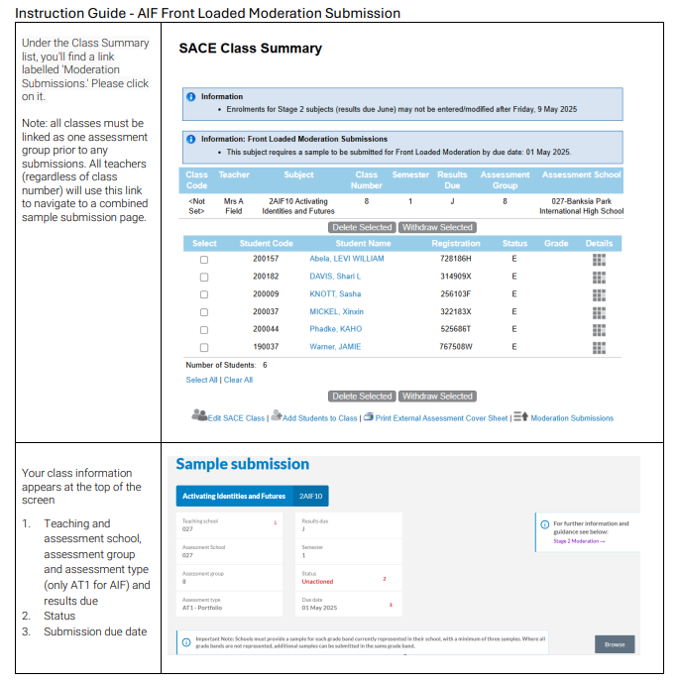
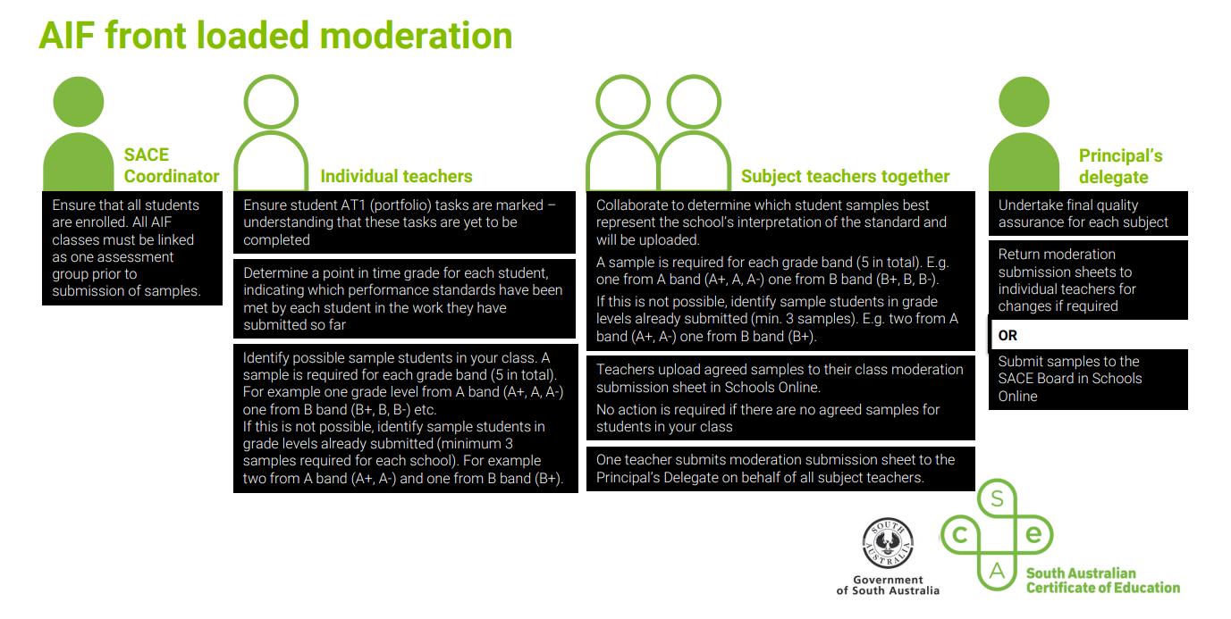
Stage 2 AIF Front Loaded Moderation Infographic
Stage 2 AIF Instruction Guide Front Loaded Moderation
Notes:
There are two documents on the AIF website that support the process of uploading materials for FLM

Slide 25

FLM On The Day
Principles of Front Loaded Moderation
Providing Effective Feedback
Benchmarking
Schools Online Process
Moderation Occurs
Notes:
On the day (4th May – Monday of Week 2, Term 2) FLM will follow these steps

Slide 26

Overview of FLM Process
Present sample
Review sample and make a decision
Enter comments
Enter details for the sample
Can you confirm?
Hand up and call over a supervisor
Discuss sample
Resolve decision
Notes:
So, what will the process of undertaking moderation actually look like?
You’ll be working in groups of three, where one of your group will be a representative from the school CLICK
You will work through the process one sample at a time
We recommend that you start from the lowest grade and work your way up. However, if there’s one grade that the teacher from the school wants to start from, start there. CLICK
Review the sample for the grade together; work through if you think you can confirm the grade or not. If you can confirm, great! CLICK
Review the other samples and grades in the same way.
IF YOU CAN CONFIRM all grades continue to fill out feedback section, complete the PSR record and move on to the next school.
One aspect of FLM that some of you won’t have encountered is the teacher representative for the moderated school will also be entering comments from moderation to go back to the school. It is important to know that the accuracy of these comments is a shared responsibility for all moderators in the group CLICK
IF YOU CANNOT CONFIRM – STOP. Call over a supervisor. CLICK
The supervisors role is to moderate your conversation, to check in about your discussion of the explicit evidence you can see in the sample to support your assessment decision against the performance standards.
This conversation will go one of two ways: after the conversation, you can confirm, or you can’t confirm. CLICK
Either way, you select the decision, and then fill out the PSR record and complete the feedback.
The supervisors are experienced AIF teachers, generally who were part of the pilot, and who have a sound understanding of the subject and the application of the performance standards, in fact I believe that some of our 2025 supervisors are here today! They are there to support discussions and answer questions throughout the day.

Slide 27
Written Feedback Principles
The feedback should always indicate what evidence we are looking at
The tone should be professional and focused on the evidence in the sample, not the teacher who marked the work
The feedback should illuminate what is important for someone to focus on; what actually matters
Notes:
One piece of advice we give moderators on the day is that once the feedback is back in the school you won't be there to clarify or point out what it was you were looking at when you made the decision, so they need to ensure that the person reading the feedback knows explicitly what evidence you identified and what criteria you were referring to.
Moderators are writing feedback on behalf of the SACE Board, and as such it needs to be professional and focus on the samples provided, not the teacher/s or school who marked the work.
The feecback overall needs to be constructive and highlight where the correct decisions were made or point out where/how teachers can improve to support their students.

Slide 28
After FLM
Schools receive communication the FLM results and feedback are available from the SACE Class Summary Screen in Schools Online
Schools will receive notification of “Confirmed” or “Not confirmed”
Feedback for each samples submitted can be viewed in schools online
If confirmed, an Attestation Letter will be available for download
Notes:
Usually within 2 weeks of FLM occurring, schools are able to access their feedback.
SACE Coordinators and/or Principal’s Delegates will receive communication when the feedback is available through schools online, along with instructions on how to access the feedback.
At this time schools will receive confirmation of if they have been confirmed or not confirmed (although the teacher attending on the day will also be aware of this status through their moderation discussions)
When a school is confirmed, they will receive an Attestation Letter specific to that semester.

Slide 29
After FLM: Confirmed
If CONFIRMED, the following must be done for final resulting at the end of the semester:
AT1 final grades for each student must be entered in Schools Online
A copy of the completed Attestation should be uploaded in place of the sample that would normally be requested (Including A+ samples)
Grades and student samples for AT2: Progress Checks must be uploaded
Grades and student samples for AT3: Appraisal should be uploaded
Notes:
So what happens at the end of the semester if a school is confirmed at FLM?
Confirmation means that schools do not need to submit student samples for AT1, and this includes at the A+ level. Final results do need to be recorded in schools online, but in place of work samples, schools should upload the competed Attestation instead.
Confirmed schools still need to submit AT2 samples and grades as usual, and this also applies to AT3, the appraisal. Grades and work samples are still required.
End of semester moderation will occur as usual, however, where moderators see an attestation letter they confirm the grades provided.

Slide 30
After FLM: NOT Confirmed
If NOT CONFIRMED, the following must be done for final resulting at the end of the semester:
Grades and samples for AT1: Portfolio must be uploaded
Grades and samples for AT2: Progress Checks must be uploaded
Grades and samples for AT3: Appraisal must be uploaded
Notes:
So what happens if a school is not confirmed at FLM?
End of year resulting occurs as normal. Student grades and work samples are required for AT1. These do not need to be the same students submitted for FLM. They should be the most representative of the grade band for that site, as is the regular process.
Grades and student samples are also required for AT2 as is usual, the same with AT3.

Slide 31
Questions?
Notes:
Hopefully this has been informative and I have not bored you to tears!
If you have any questions I will be here for a while if you have a specific question or for those 3am thoughts that may come to you later please reach out to our askSACE team who will direct you to me or a member of my team to support you.
Thank you for having me here today and I hope you all enjoy your day and have a happy Valentine’s day!

Slide 32
askSACE@sa.gov.au 1300 322 920
Notes:
Hopefully this has been informative and I have not bored you to tears!
If you have any questions I will be here for a while

