Slide 1
New to SACE/AIF Teachers – ASRT Conference 2026
Maddie O'Brien-Dent – Yr 11/12 Senior Leader Modbury High School
Mainstream Semester 2 class
Tailored Learning Years 10–12 mixed-subject full year class (including AIF)

Slide 2
What I’ve Learnt... (Besides forming a toxic situationship with AIF and witnessing a whole-class epiphany that feedback is, in fact, not a personal attack)

Slide 3
Structure
AT1 - Portfolio of natural evidence 35% (no word/page/time limit)
AT2 – 2 or more Progress Checks 35% (1500 words/10 mins combined limit)
Output of Learning – not weighted or assessed (Appraised in AT3) (no formatting requirements)
AT3 – Appraisal 30% (1000 words or 6 minutes) – external assessment, goes to SACE first

Slide 4
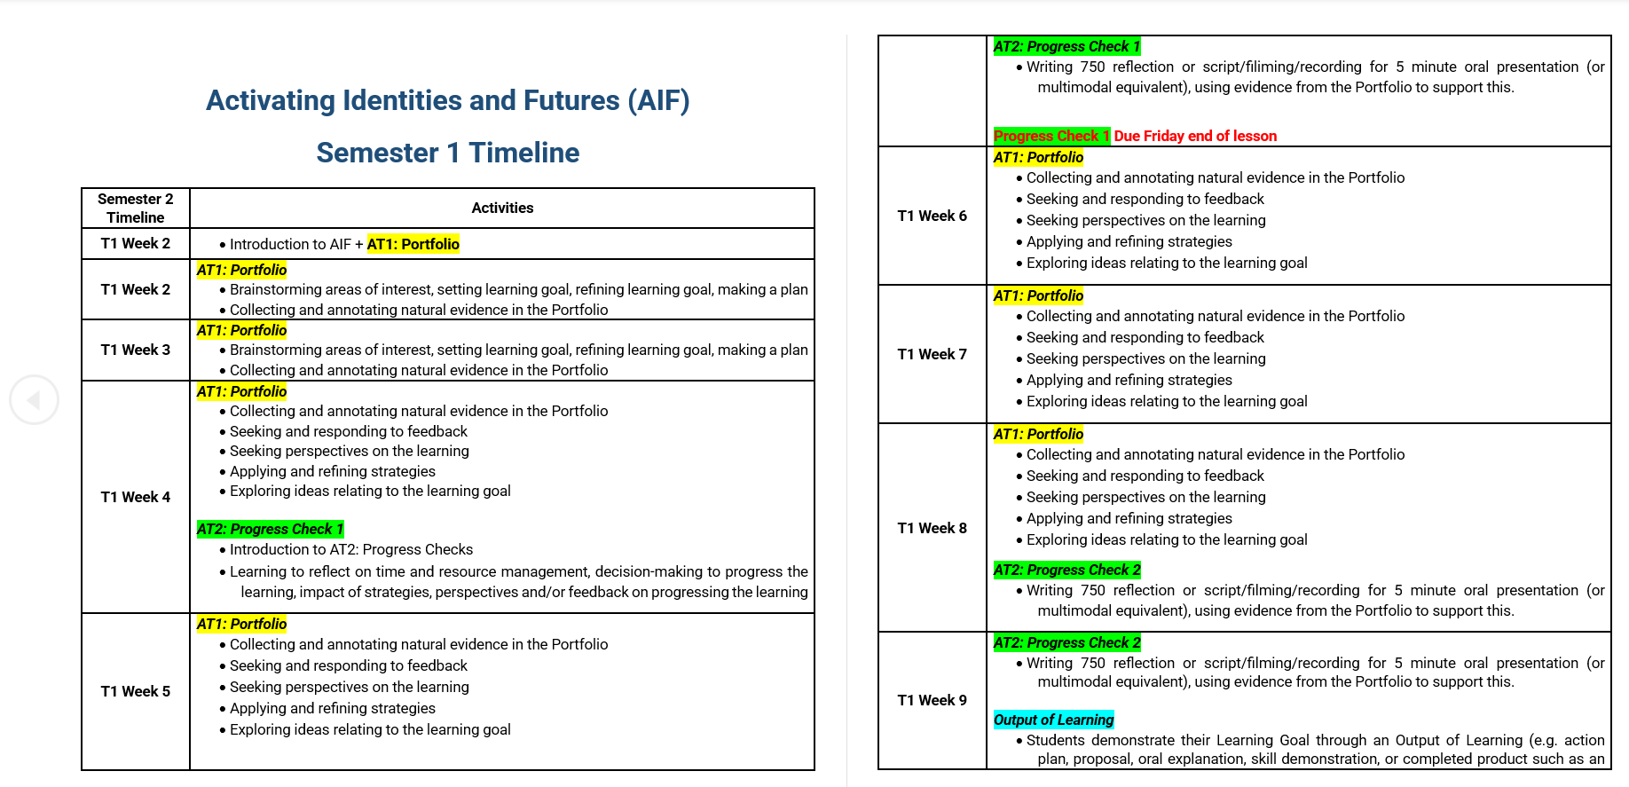

Slide 5
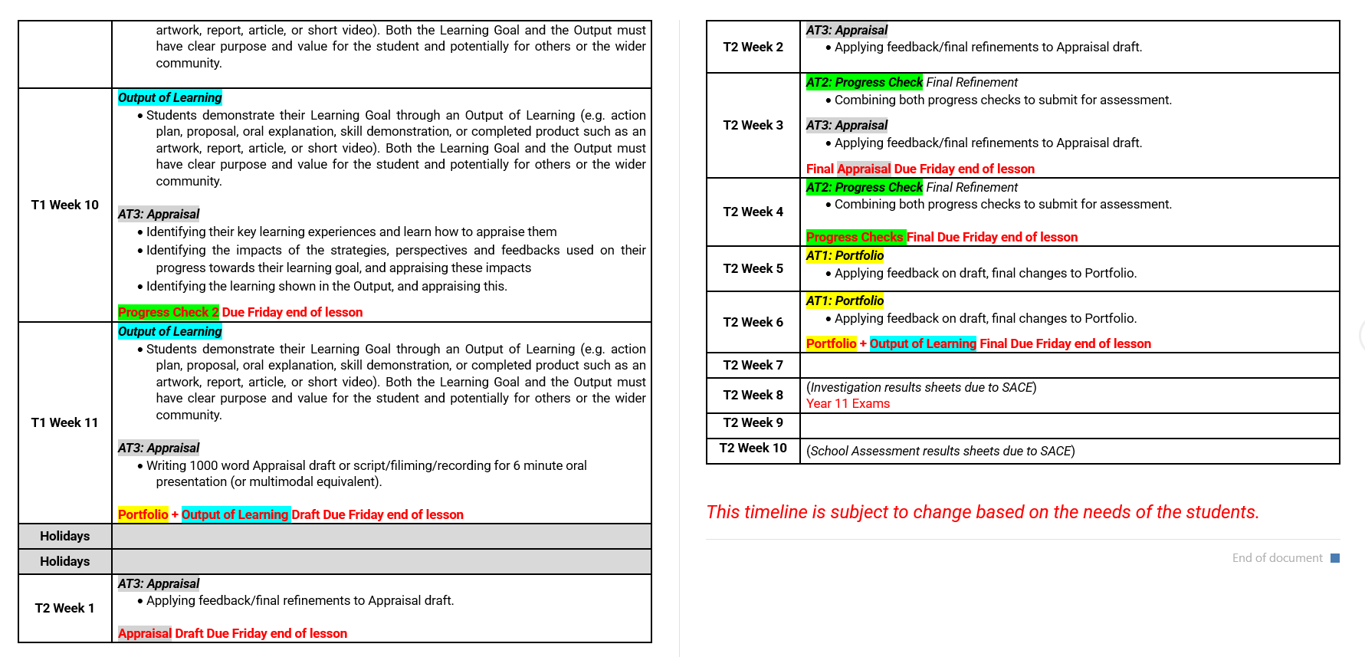

Slide 6
Portfolio
The importance of habit when building evidence
Weekly reflections worked well for many students across both classes.
This connected well to time management and made Progress Checks easier for those who kept up with it.
The routine provided enough structure for students who struggled with the open-ended nature of the assessment type.

Slide 7
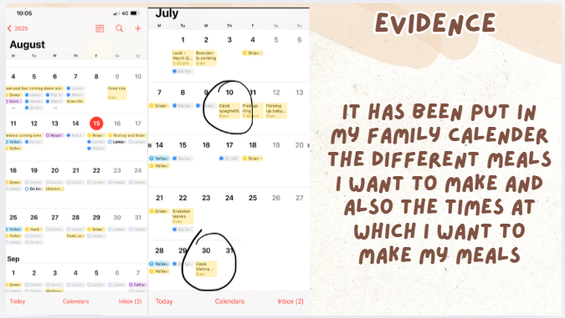
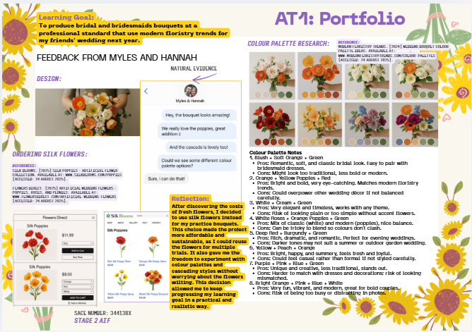
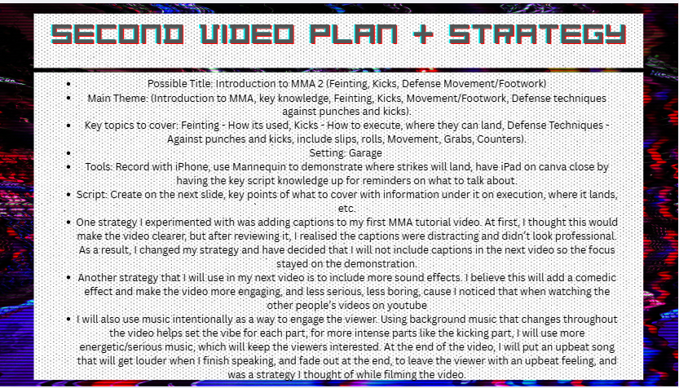
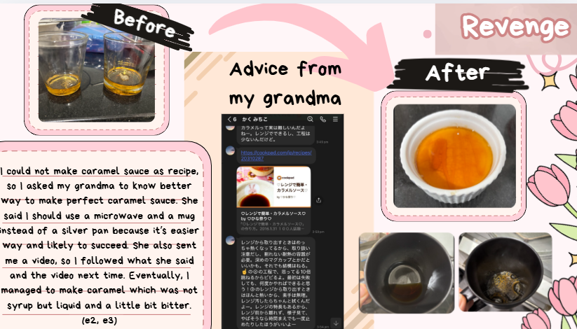
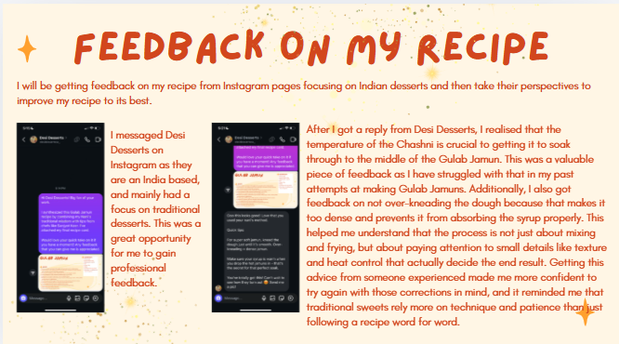

Slide 8
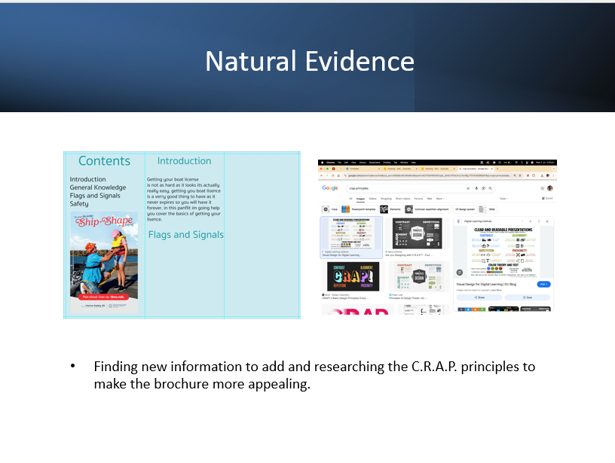
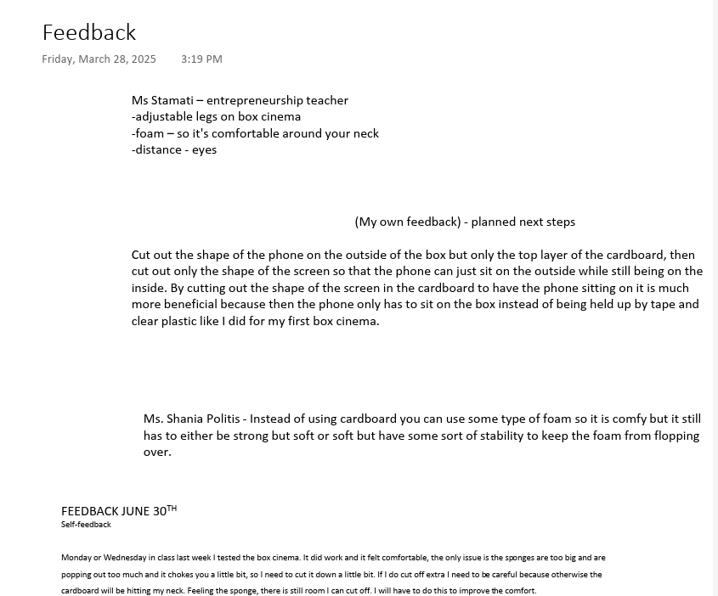
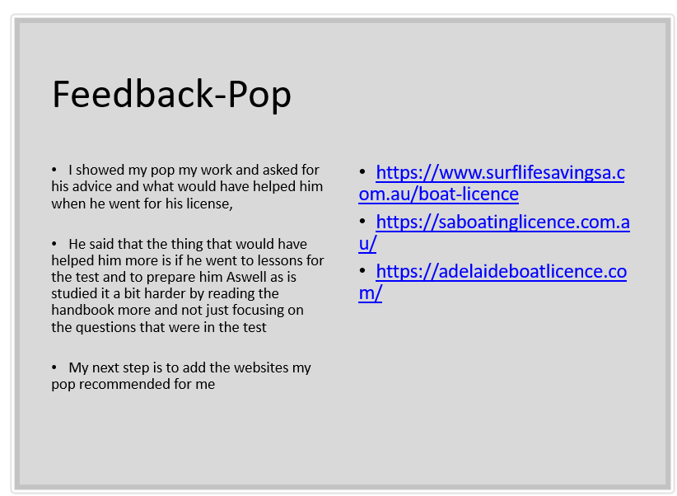
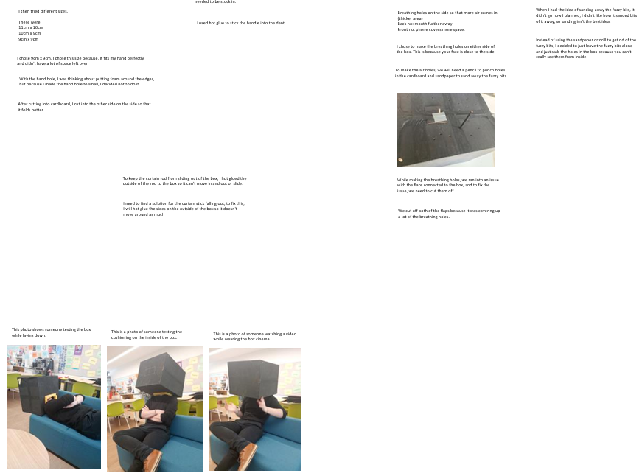

Slide 9
Portfolio Performance Standards
E1 Exploring ideas related to an area of interest
E2 Selecting and applying strategies
E3 Selecting and using perspectives
PA1 Seeking and responding to feedback

Slide 10
Progress Checks
Timing matters (PA2)
Students can’t do a Progress Check with no progress, they need to have started “doing”.
Schedule checks early enough that there’s still time to change direction afterwards.
This is where we see how they manage time and resources (PA2).
Real evidence - the less contrived the better (PA3)
Students bring 2–3 Portfolio pieces (photos, reflections) that show what they’ve actually done.
Ask: What did you decide to do next, and why?
That talk-through shows their judgements and decisions (PA3).
Talk about impact, not just description (A2)
Ask: Which strategy/perspective/feedback helped most? How did it change your learning?
These explanations are where they appraise the impact of strategies, perspectives and feedback (A2).

Slide 11
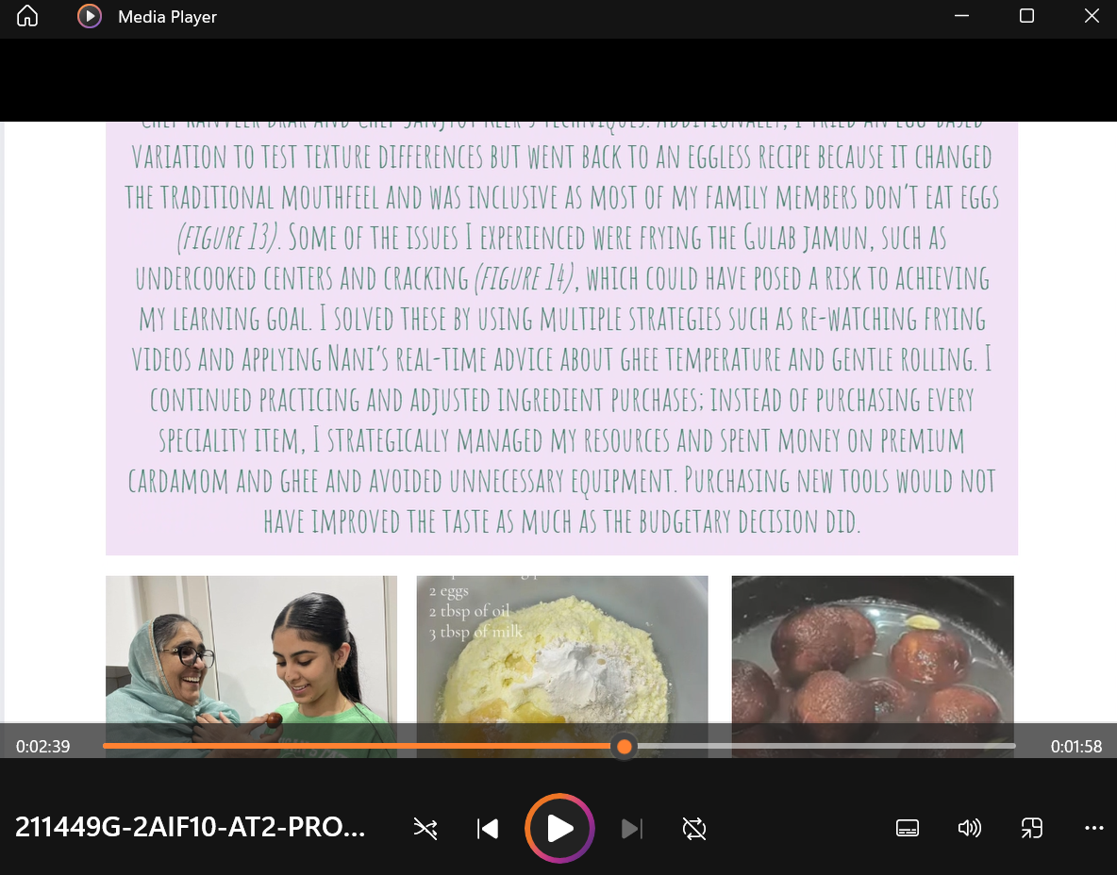
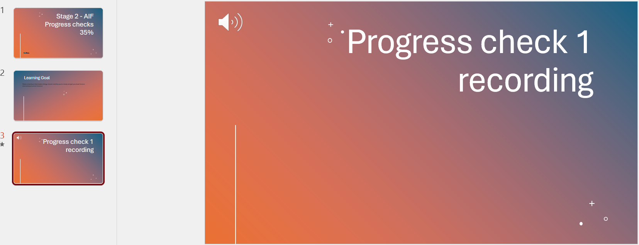
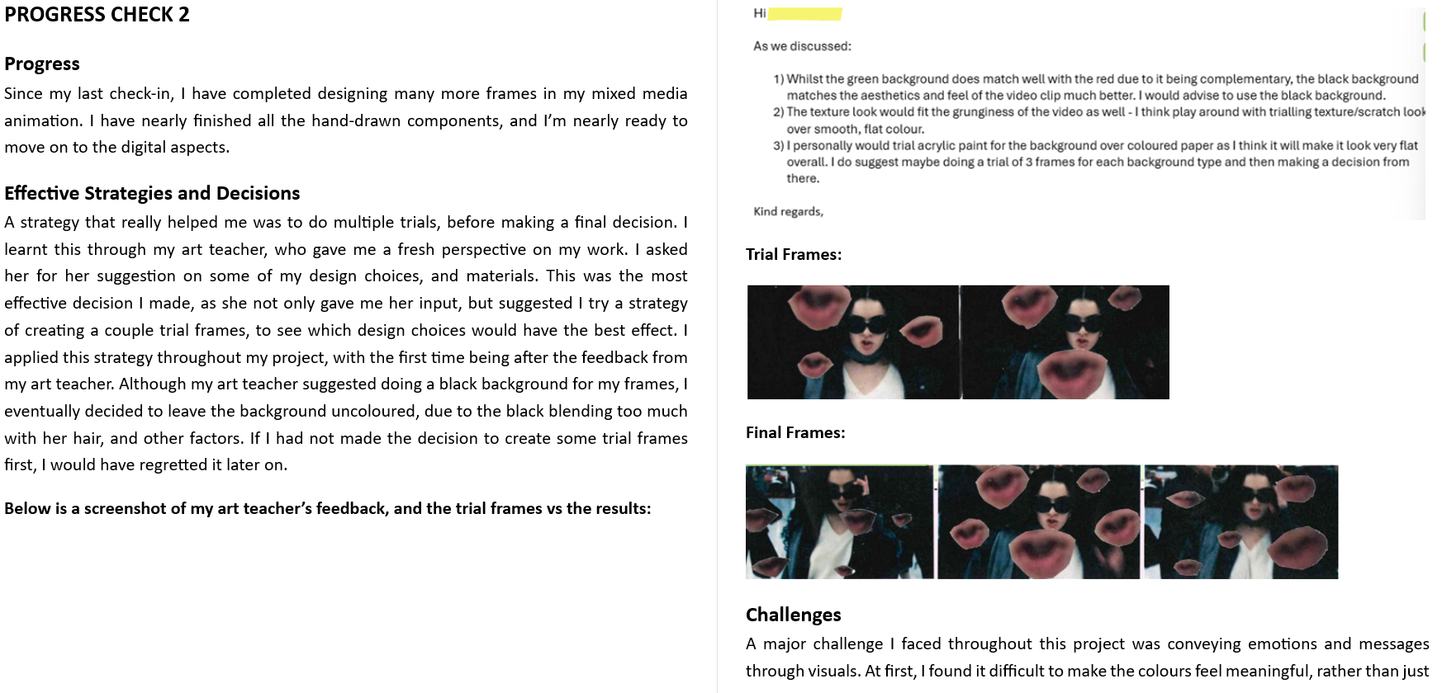

Slide 12
Progress Check Performance Standards
PA2 Managing time and resources
PA3 Making judgements and decisions
A2 Appraising the impact of strategies, perspectives and/or feedback to progress the learning towards the learning goal

Slide 13
Output of Learning
Lack of early focus on the final product meant the end felt rushed, stressful, and led to weaker Appraisals and less pride in the work.
Students had strong thinking and evidence of learning, but not enough time or structure to demonstrate that level of learning in a tangible way.
Next time: lock in clear Output options early, build in a specific draft checkpoint, and protect time towards the end for refining (& connect to A3!).
TL class
This wasn't an issue at all as they all created something from the get-go!

Slide 14
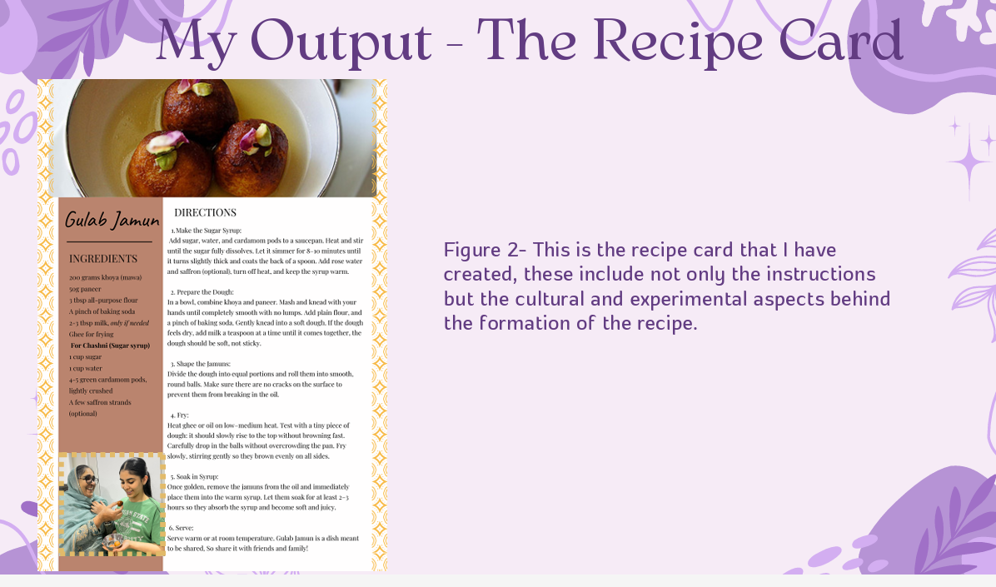
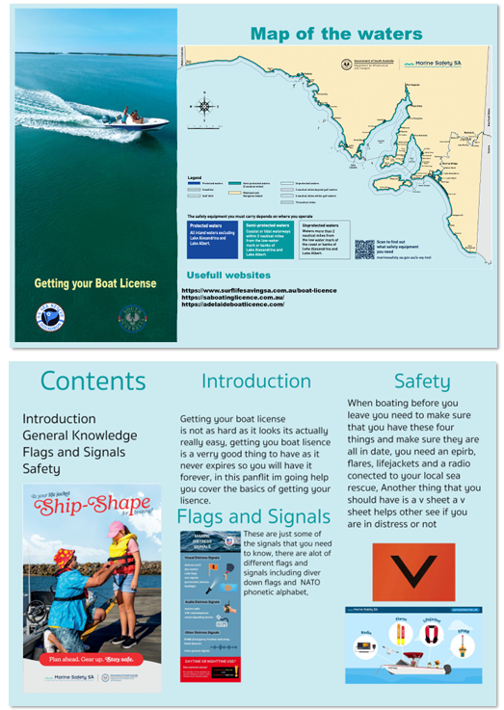
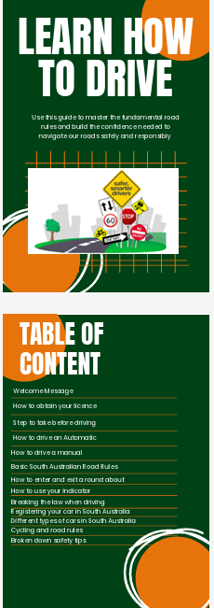
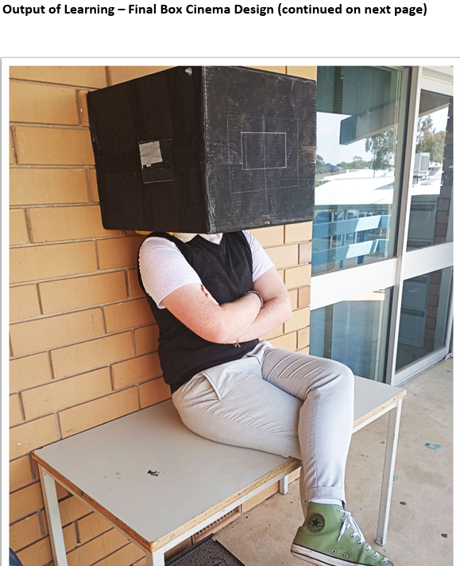
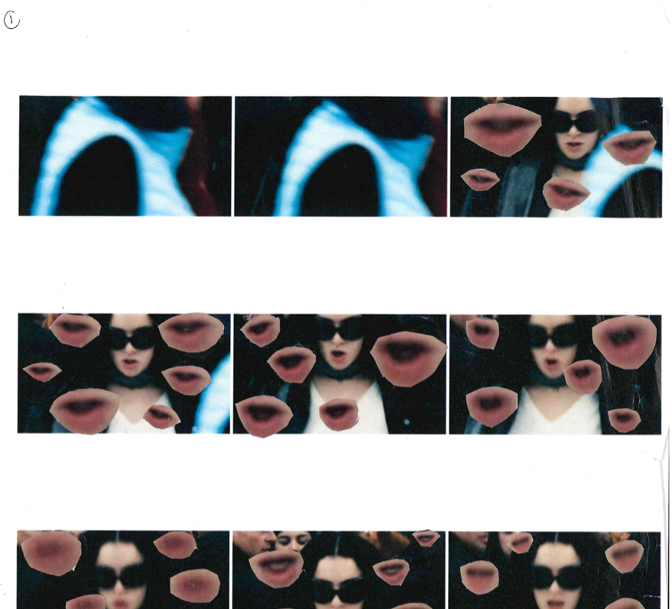
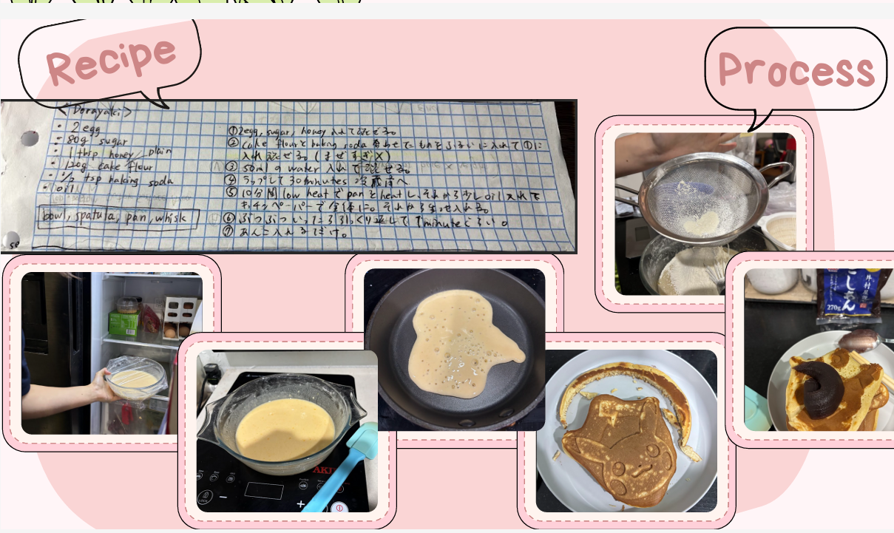

Slide 15
Appraisal
Storytelling is your friend! (A1)
If students can tell an honest story about how the learning affected them, with specific moments and examples, they're over halfway there!
“What actually moved your learning forward?” (A2)
This pushes them into cause-and-effect thinking
The phrase 'and then what?'
Normalising honest evaluation (A3)
what worked / what didn’t / what next

Slide 16
Appraisal Performance Standards
A1 Appraising the personal value of the learning experiences
A2 Appraising the impact of strategies, perspectives and/or feedback to progress the learning towards the learning goal
A3 Appraising learning development as represented in the Output of Learning

Slide 17
What Works Well…
Explicit teaching activities for performance standards
Rank/mark sentences for each Assessment Type against the PS - discussion
Model A-level thinking and writing - 'get it from C > B > A'
Being honest
Key for building relationships – they most likely know it's your first time!
Own your mistakes
Get comfortable being uncomfortable (harness the no-template approach)
Use the language of the performance standards/subject outline from the get-go
Use for all assessments to guide conversations
Students pick it up way more than you think!

Slide 18
Tailored Learning
Create something where peers are the target audience (L's booklet, boat license brochure, box cinema, metal sculpture, colouring pages)
Easy to get feedback
Easy to get different perspectives in an intentional way that was meaningful to students
Easy to test strategies
Utilise resources within the school
The beauty of natural evidence
Absolutely embrace this!

Slide 19
Resources
School AIF Pages -
https://www.thielelibrary.website/activating-identities-and-futures-for-2024.html
https://urrbraeaif.weebly.com/
SACE Calendar - https://www.sace.sa.edu.au/calendars/sace
SACE AIF Page - https://www.sace.sa.edu.au/studying/subjects/activating-identities-and-futures

Slide 20
Questions?

