Slide 1
Activating IF Unpacking the language and guiding principles of the AIF
Guided by the SACE Thrive ethos, AIF seeks to empower students to become capable, self directed learners. This session will unpack the key concepts, skills and terminologies for teacher facilitators to empower their students to become independent agents for learning.
Session 2: 12:05pm-1:00pm jasmin.parasiers@gmail.com
With thanks to Tracey Dorian, Virginia Grantham and Mandy Loveder for their contributions
This presentation was prepared and delivered on Kaurna land.

Slide 2
PRE - SURVEY
Pilot 1? Pilot 2? Full Cohort? Small Group? Mainstream? Alternative?

Slide 3





DISCLAIMER
Pilot 1 Learner Hub

Slide 4
The role of the learning output... from the beginning...
Structural Check In…
30% AT1 Portfolio = collection of natural evidence...in order to create a valid, reliable, credible...response/answer/product
40% AT2 Progress check = STOP and reflect on how the learning is progressing in regard to creating that valid, reliable, credible response...and what needs to be done next in order to....
0% = Learning output HOWEVER
30% AT3 Appraisal = Reflect on the value of the learning and learning output and also strategies used in order to get to the most valid, reliable, credible, appropriate, useful, clear response/answer/product...
Notes:
1.50pm

Slide 5
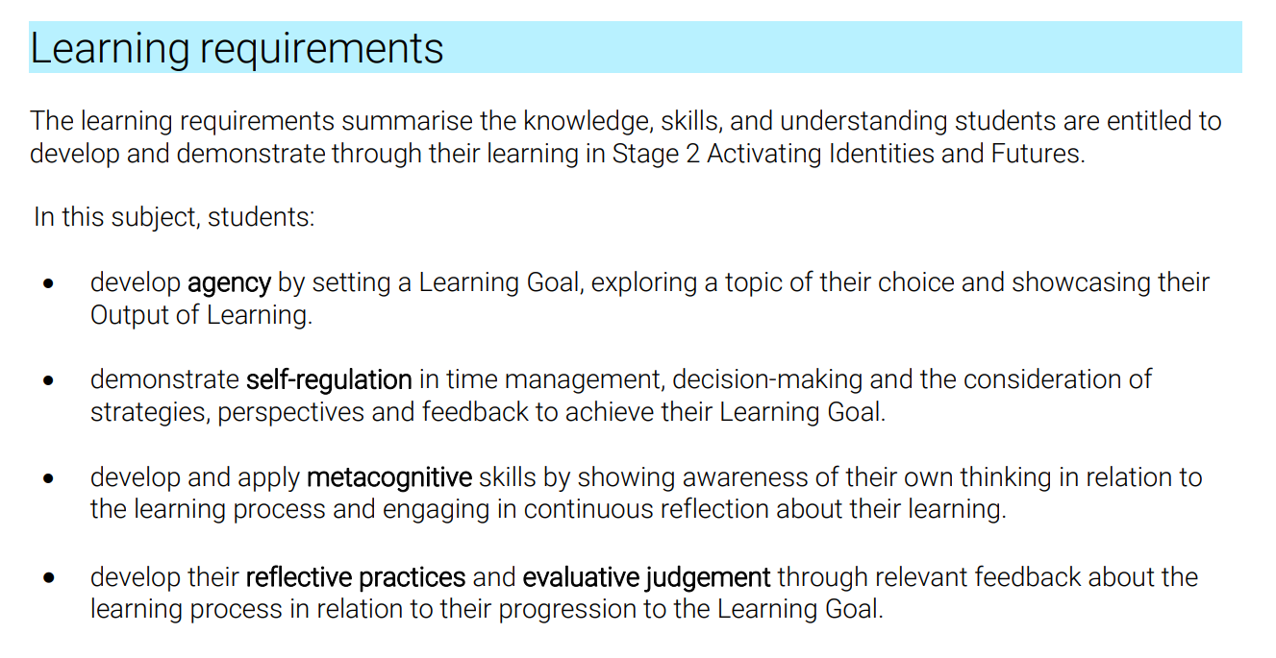

Underpinning Concepts
Guided by the SACE Thrive ethos, AIF seeks to empower students to become capable, self directed learners.
https://www.sace.sa.edu.au/innovating/revitalising-rp/stories-of-change

Slide 6
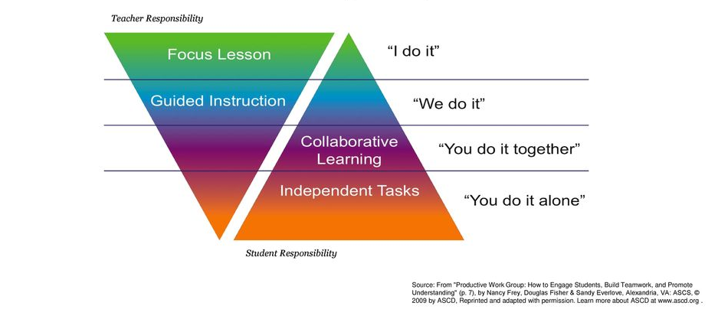
Underpinning Concepts
Guided by the SACE Thrive ethos, AIF seeks to empower students to become capable, self directed learners.

Slide 7

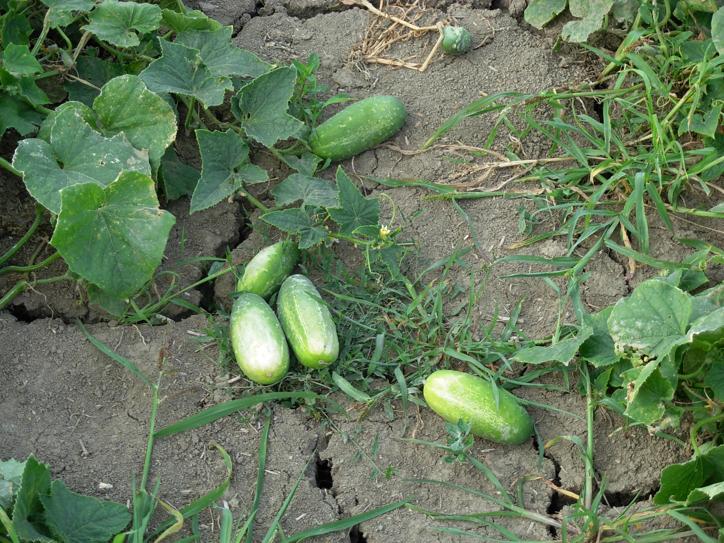
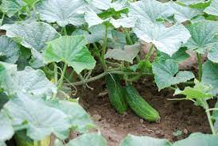
Underpinning Concepts with… Cucumbers..
Guided by the SACE Thrive ethos, AIF seeks to empower students to become capable, self directed learners.
Too much facilitation… Not enough facilitation… Just right?

Slide 8
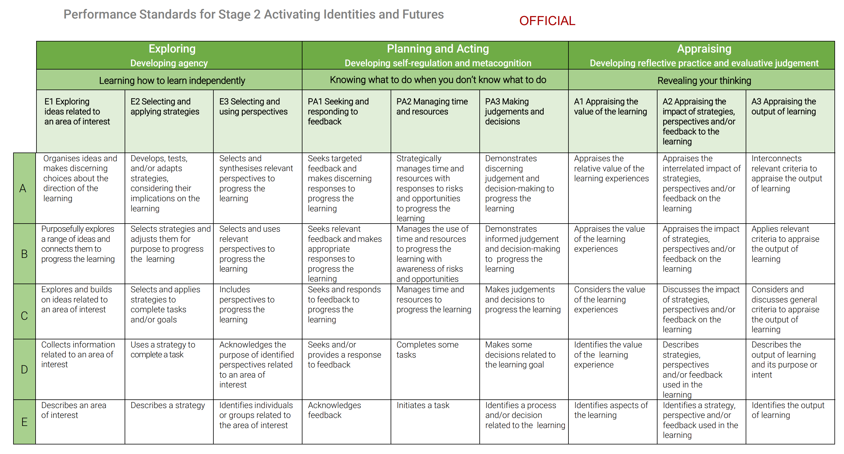
Intentional Language
What are we asking our students do to? (ACTIONS)
For what purpose? (REASONS)
At which level of sophistication? (QUALITY)

Slide 9

Intentional Language
What actions are students asked to do in order to be successful at C grade? For what purpose?
E1 | E2 | E3 | PA1 | PA2 | PA3 | A1 | A2 | A3
Explores Builds on | Selects Applies To Complete | Includes To Progress | Seeks Responds To Progress | Manages To Progress | Makes To Progress | Considers | Discusses | Considers Discusses To Appraise
What can this look like?

Slide 10
Intentional Language
What actions are students asked to do in order to be successful at A grade? For what purpose?
E1 | E2 | E3 | PA1 | PA2 | PA3 | A1 | A2 | A3
Organises Makes choices | Develops Tests Adapts Considers Impact | Selects Synthesis To progress | Seeks Makes Responses To progress | Manage To progress | Demonstrate To progress | Appraise | Appraises | Interconnects To appraise
There is a sense of cohesion, purpose, direction, impetus | Links the benefits and consequences Range of options | Explores and discerns relevance and can communicate this Thinks broadly/deeply | Targeted – not just mum & dad (unless relevant?) Responses – considers consequences | Strategic – not just a generic timeline! Responsive and dynamic | Decisions make sense, they are justifiable, they have impact, if they don’t – retries, learns from failure

Slide 11
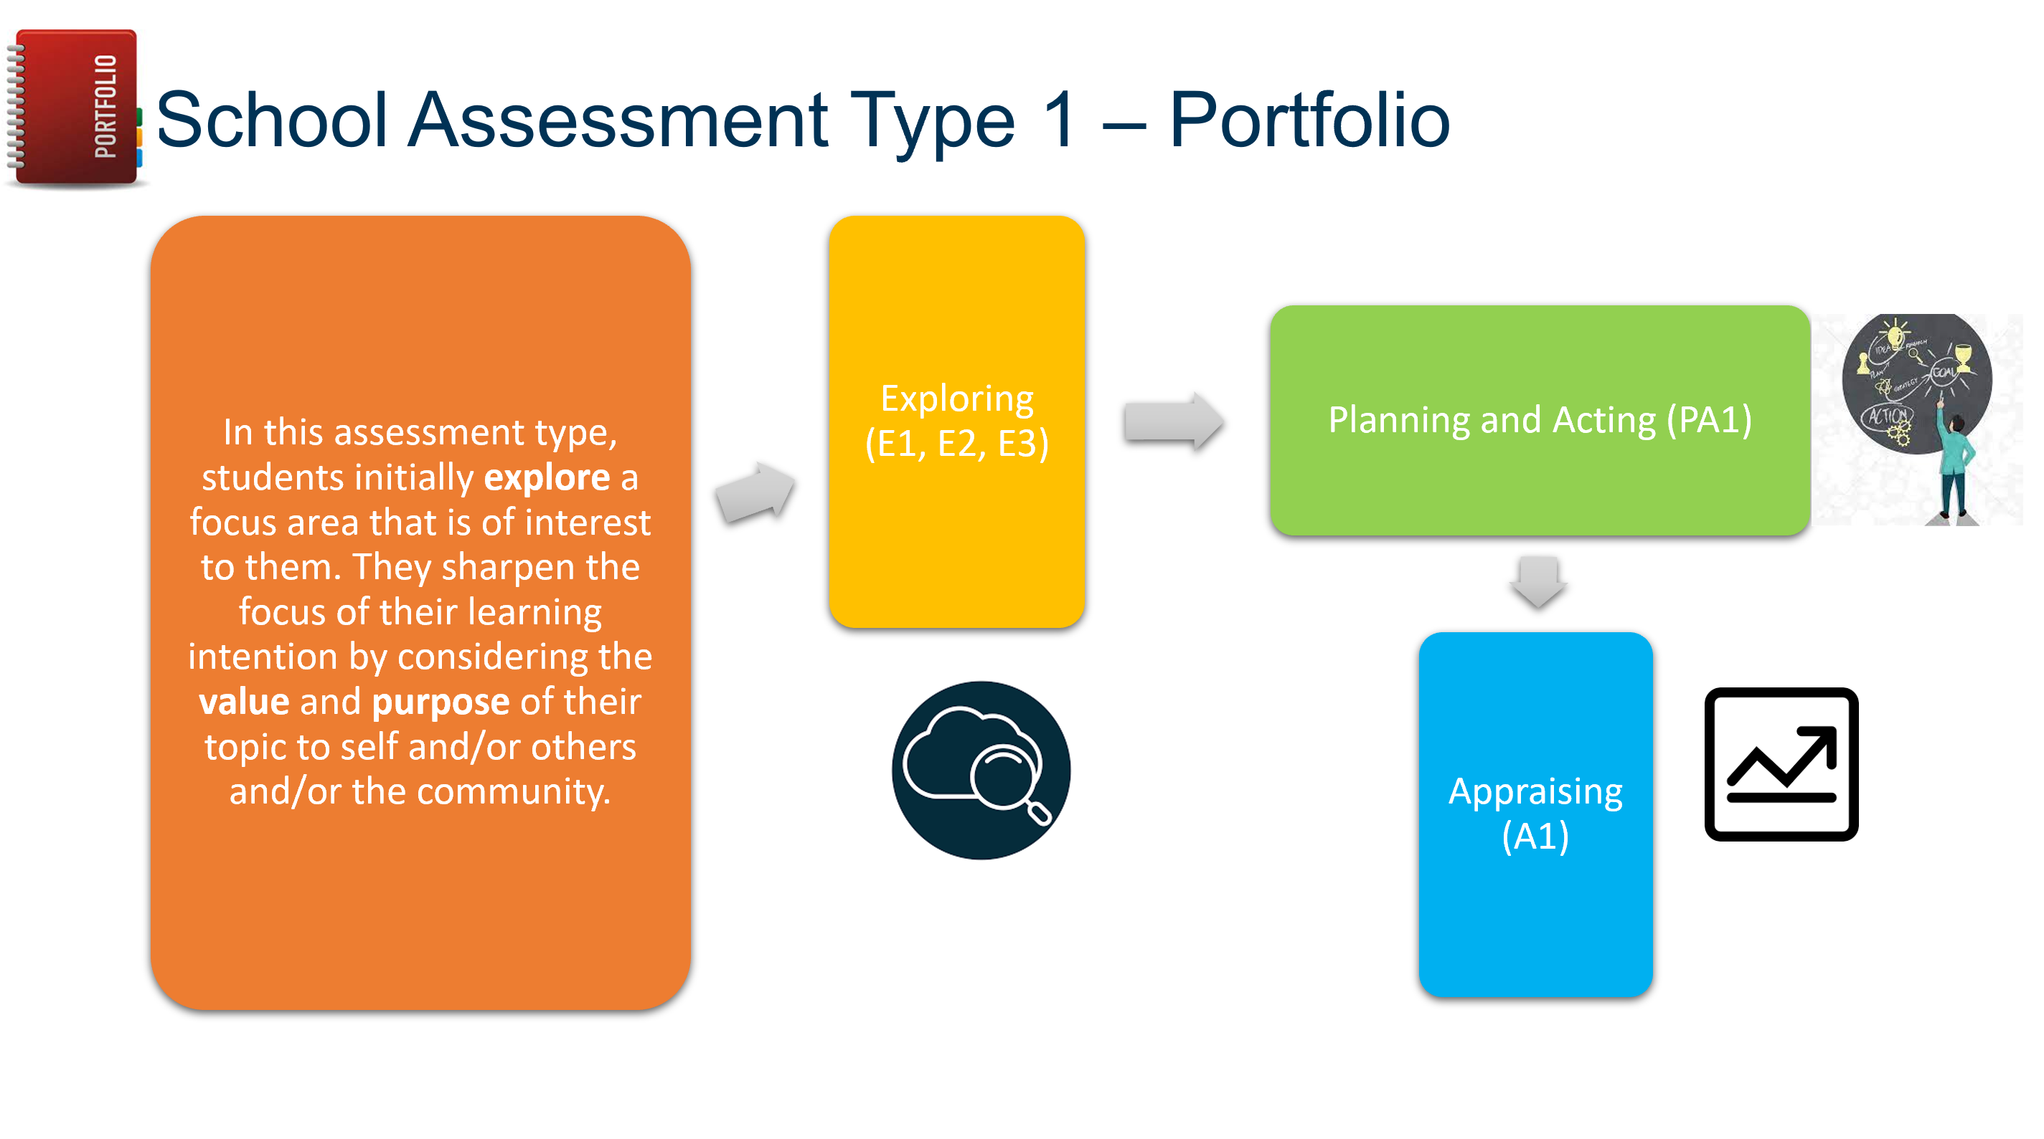
Intentional Language
What actions are students asked to do in order to be successful at A grade? For what purpose?
E1 | E2 | E3 | PA1 | PA2 | PA3 | A1 | A2 | A3
Organises Makes choices | Develops Tests Adapts Considers Impact | Selects Synthesis To progress | Seeks Makes Responses To progress | Manage To progress | Demonstrate To progress | Appraise | Appraises | Interconnects To appraise
There is a sense of cohesion, purpose, direction, impetus | Links the benefits and consequences Range of options | Explores and discerns relevance and can communicate this Thinks broadly/deeply | Targeted – not just mum & dad (unless relevant?) Responses – considers consequences | Strategic – not just a generic timeline! Responsive and dynamic | Decisions make sense, they are justifiable, they have impact, if they don’t – retries, learns from failure

Slide 12
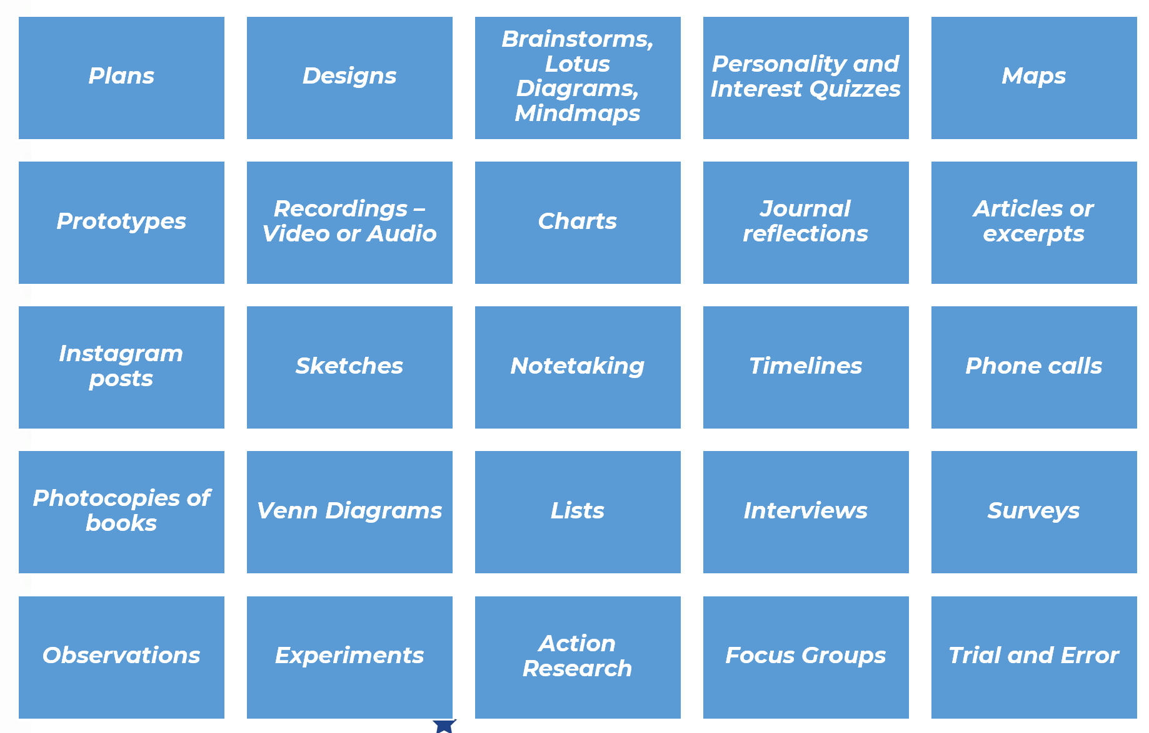
Facilitating Students to explore, plan, act and appraise…
What actions are students asked to do in order to be successful? For what purpose?
Portfolio AT1
For this assessment type, students provide evidence of their learning primarily in relation to the following assessment design criteria:
• Exploring (E1, E2, E3)
• Planning and Acting (PA1)
• Appraising (A1)
What can this look like?

Slide 13
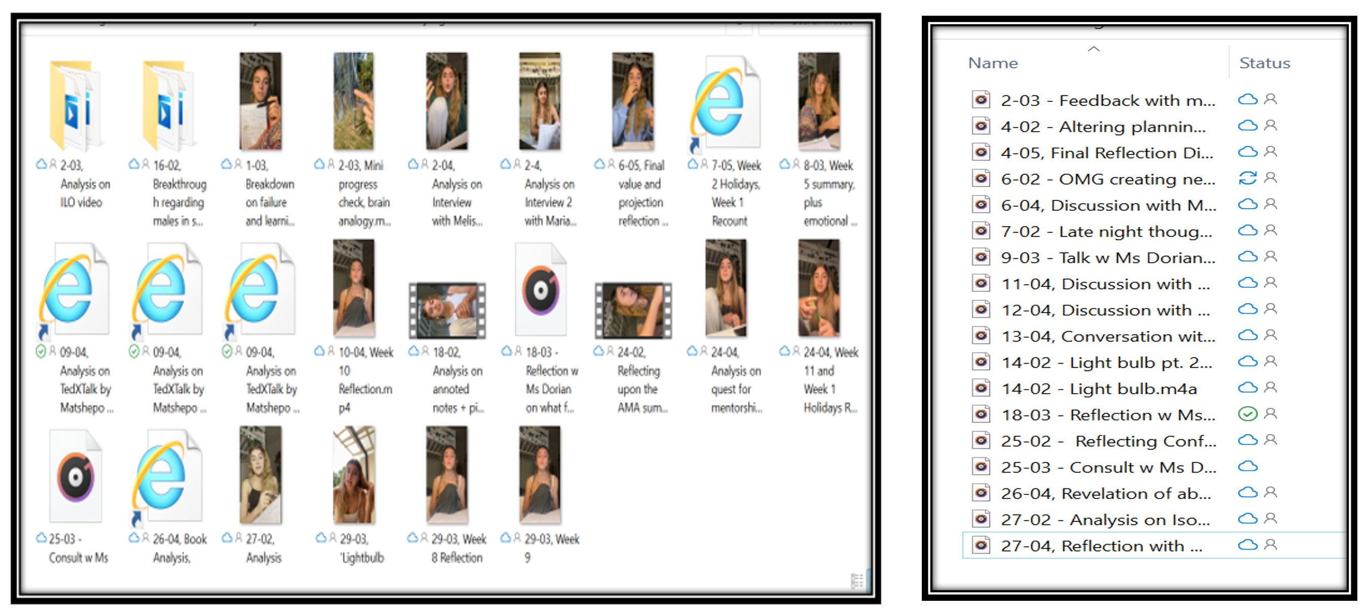
Facilitating Students to explore, plan, act and appraise…
What actions are students asked to do in order to be successful? For what purpose?
Portfolio AT1
What can this look like?

Slide 14
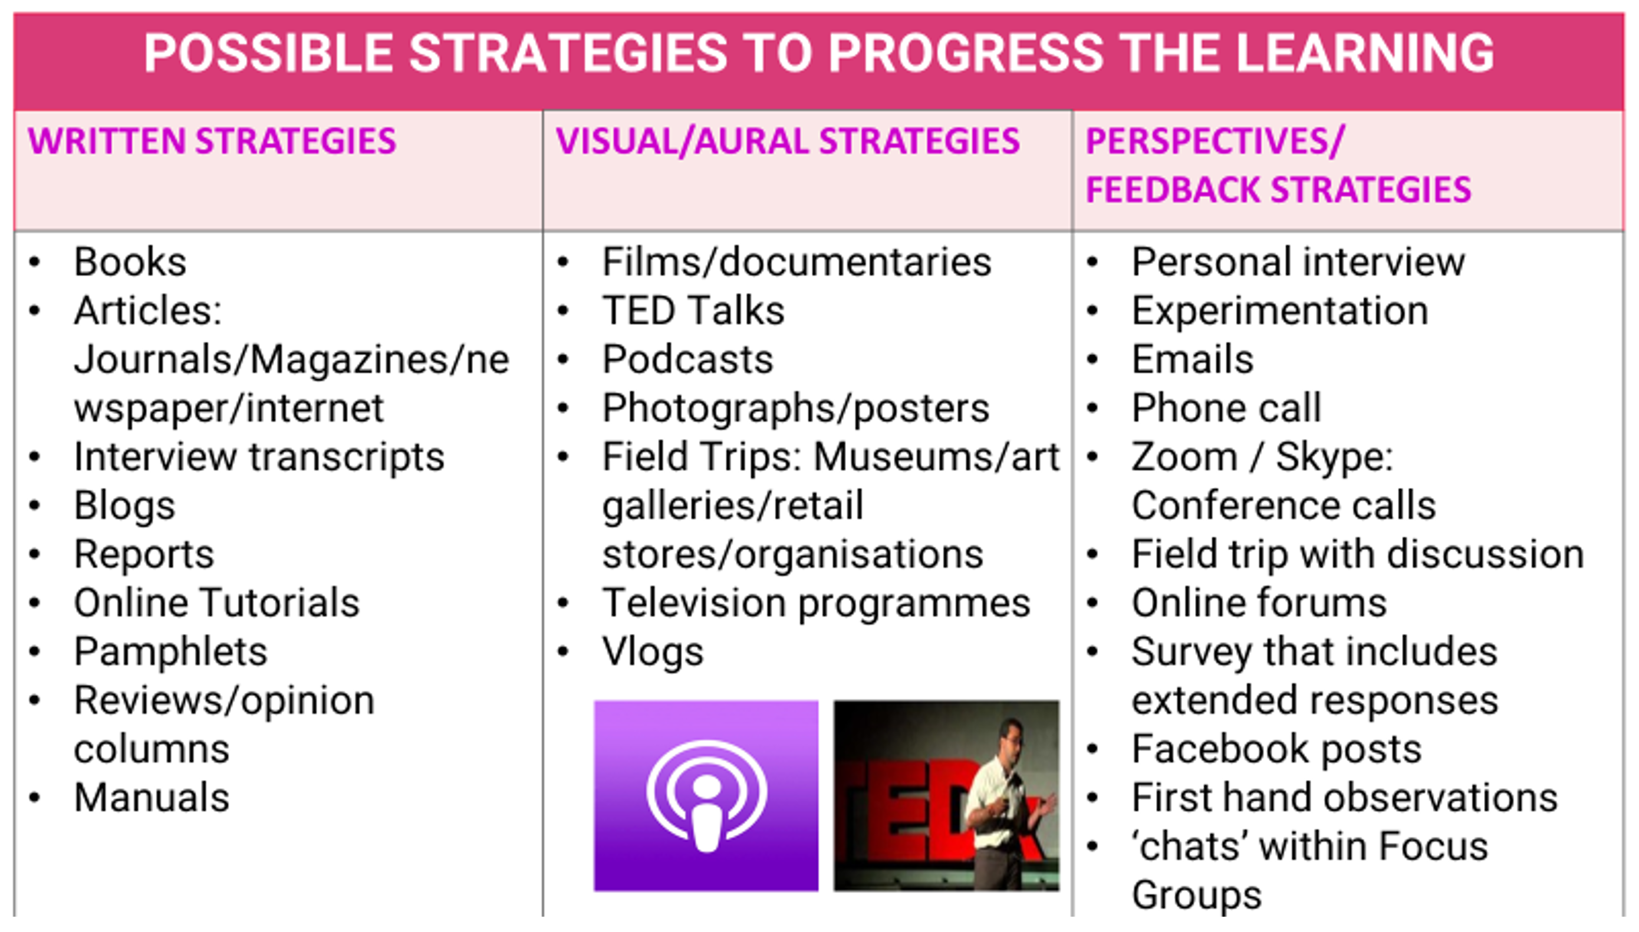
Facilitating Students to explore, plan, act and appraise…
What actions are students asked to do in order to be successful? For what purpose?
Portfolio AT1

Slide 15

Facilitating Students to explore, plan, act and appraise…
What actions are students asked to do in order to be successful? For what purpose?
Portfolio AT1

Slide 16

Facilitating Students to explore, plan, act and appraise…
What actions are students asked to do in order to be successful? For what purpose?
Portfolio AT1

Slide 17

Facilitating Students to explore, plan, act and appraise…
What actions are students asked to do in order to be successful? For what purpose?
Portfolio AT1

Slide 18
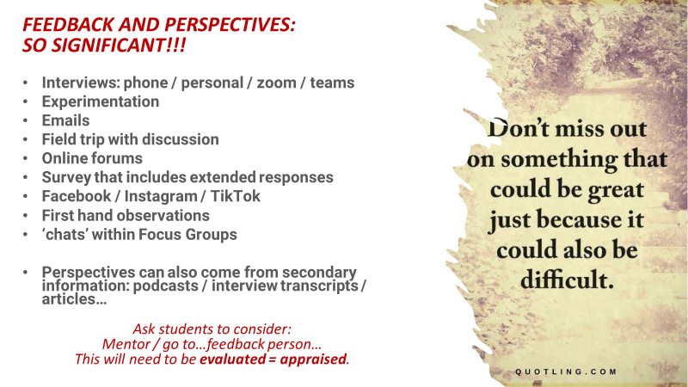
Facilitating Students to explore, plan, act and appraise…
What actions are students asked to do in order to be successful? For what purpose?
Portfolio AT1

Slide 19



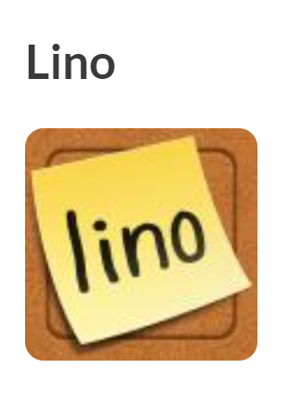
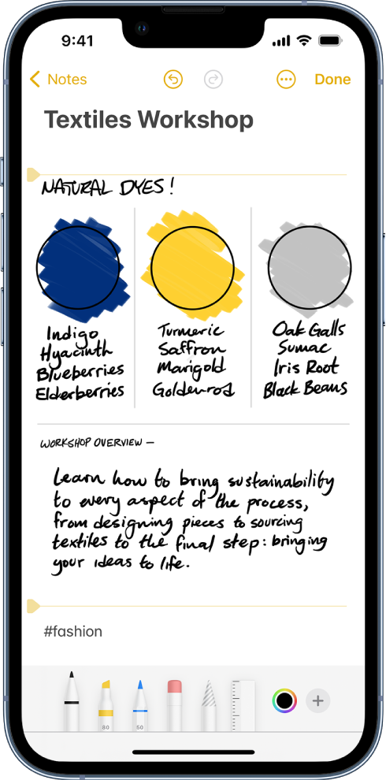

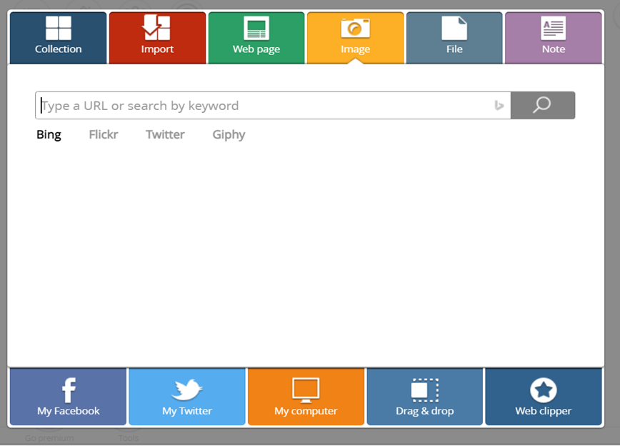

Facilitating Students to explore, plan, act and appraise…
What actions are students asked to do in order to be successful at C grade? For what purpose?
Portfolio AT1

Slide 20
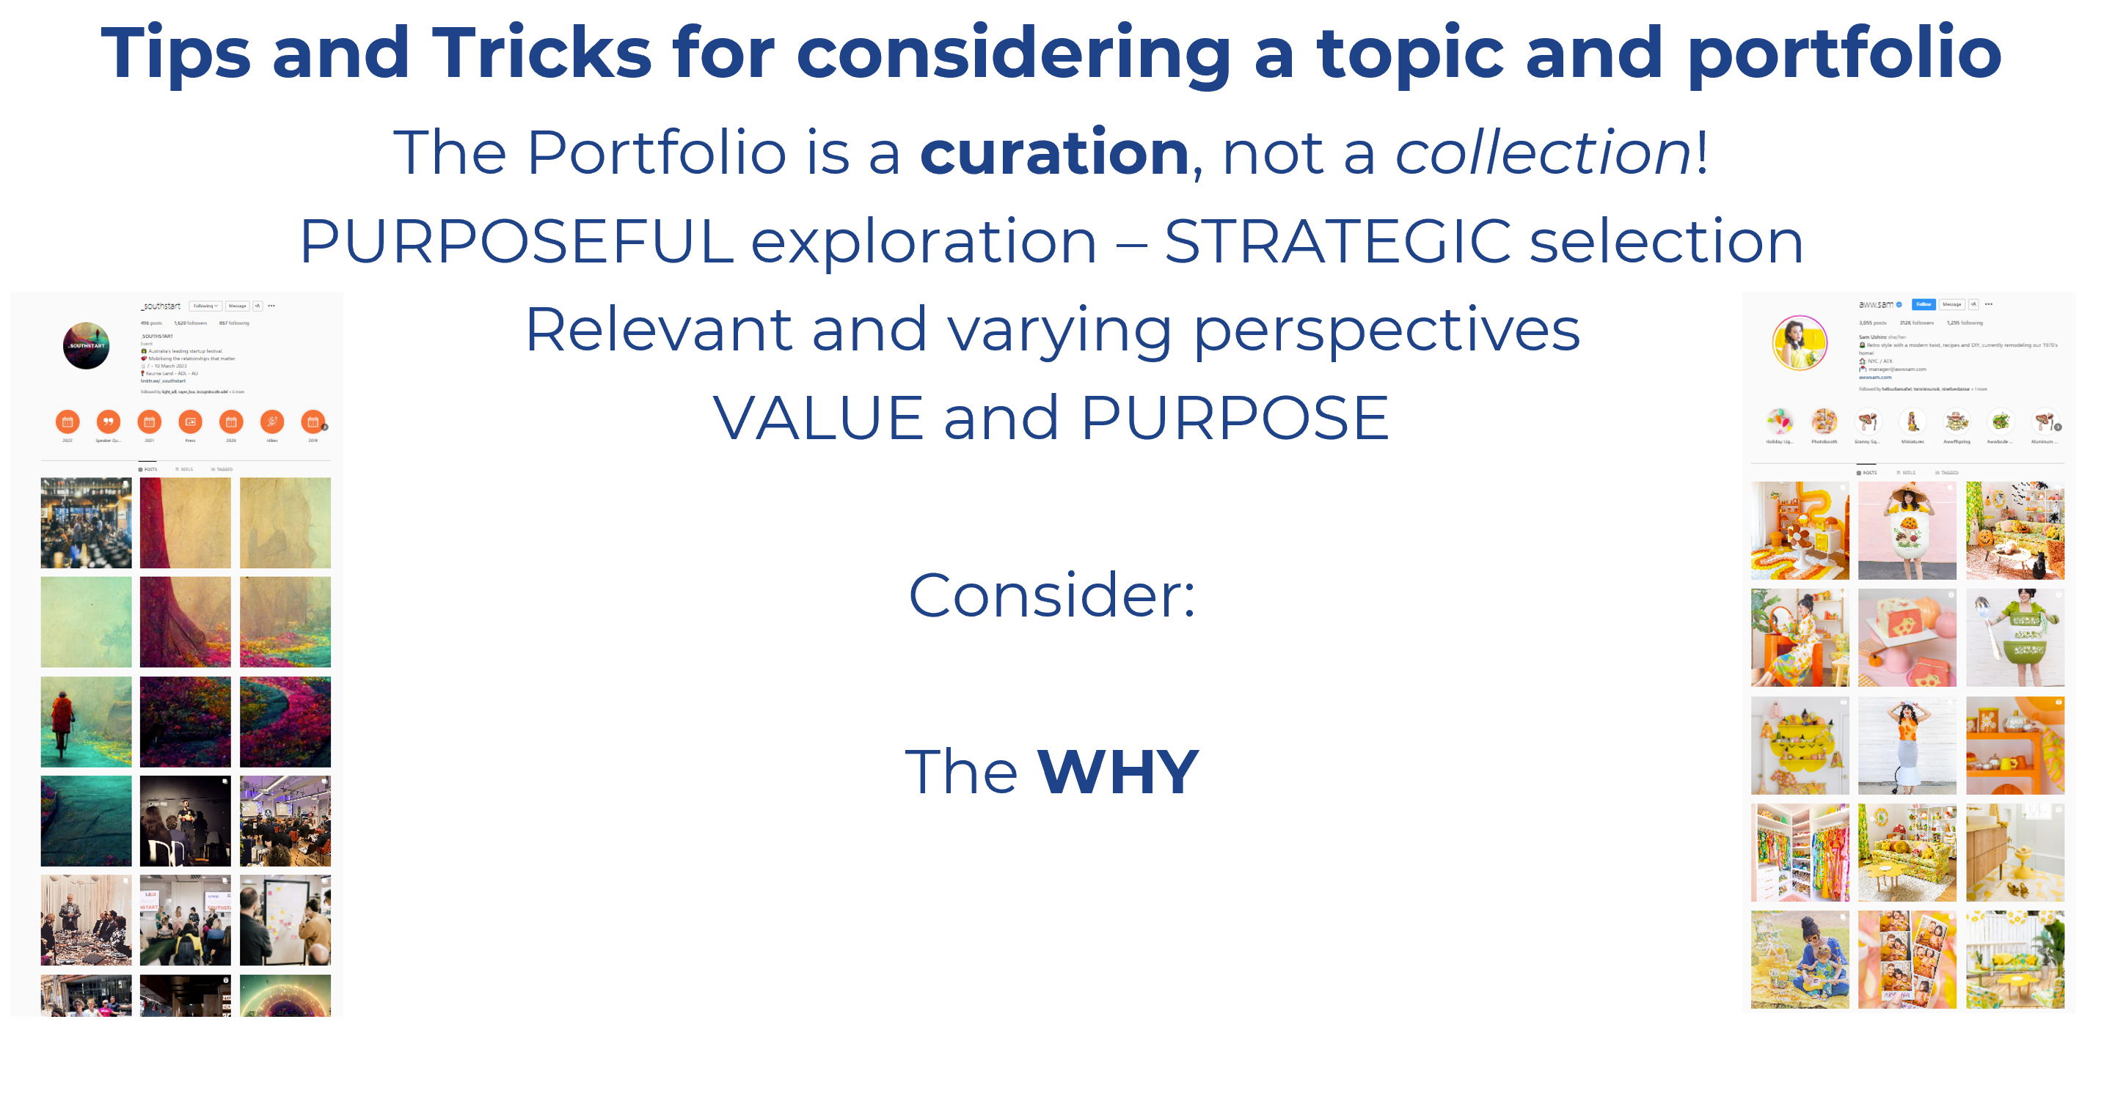
Applying it in context
More Successful learners appear to be:
Exploring the learning about learning (what IS a good curation app?)
Exploring the resources beyond the superficial
Exploring the links and ‘leap frogging’ into depth and breadth

Slide 21

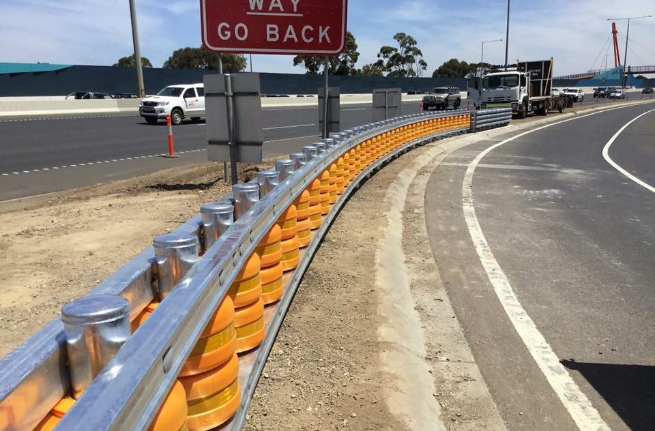
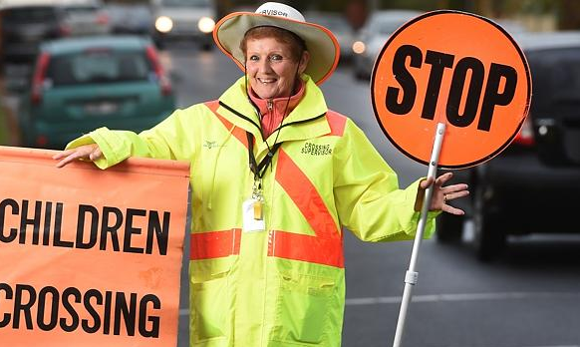
The Facilitation of Portfolio
Students need agency to direct their learning, but need to understand the assessment criteria that they will be assessed against. They must be active in the assessment process through self and peer review, to engage with these criteria authentically and regularly.
Don’t expect students to just “bump into” the specific features – they need to be unpacked with the class so that students are attune to them and can align their responses to them.
Best Practice: Working with students to understand performance criteria should encourage open, flexible, creative and dynamic responses and action plans

Slide 22
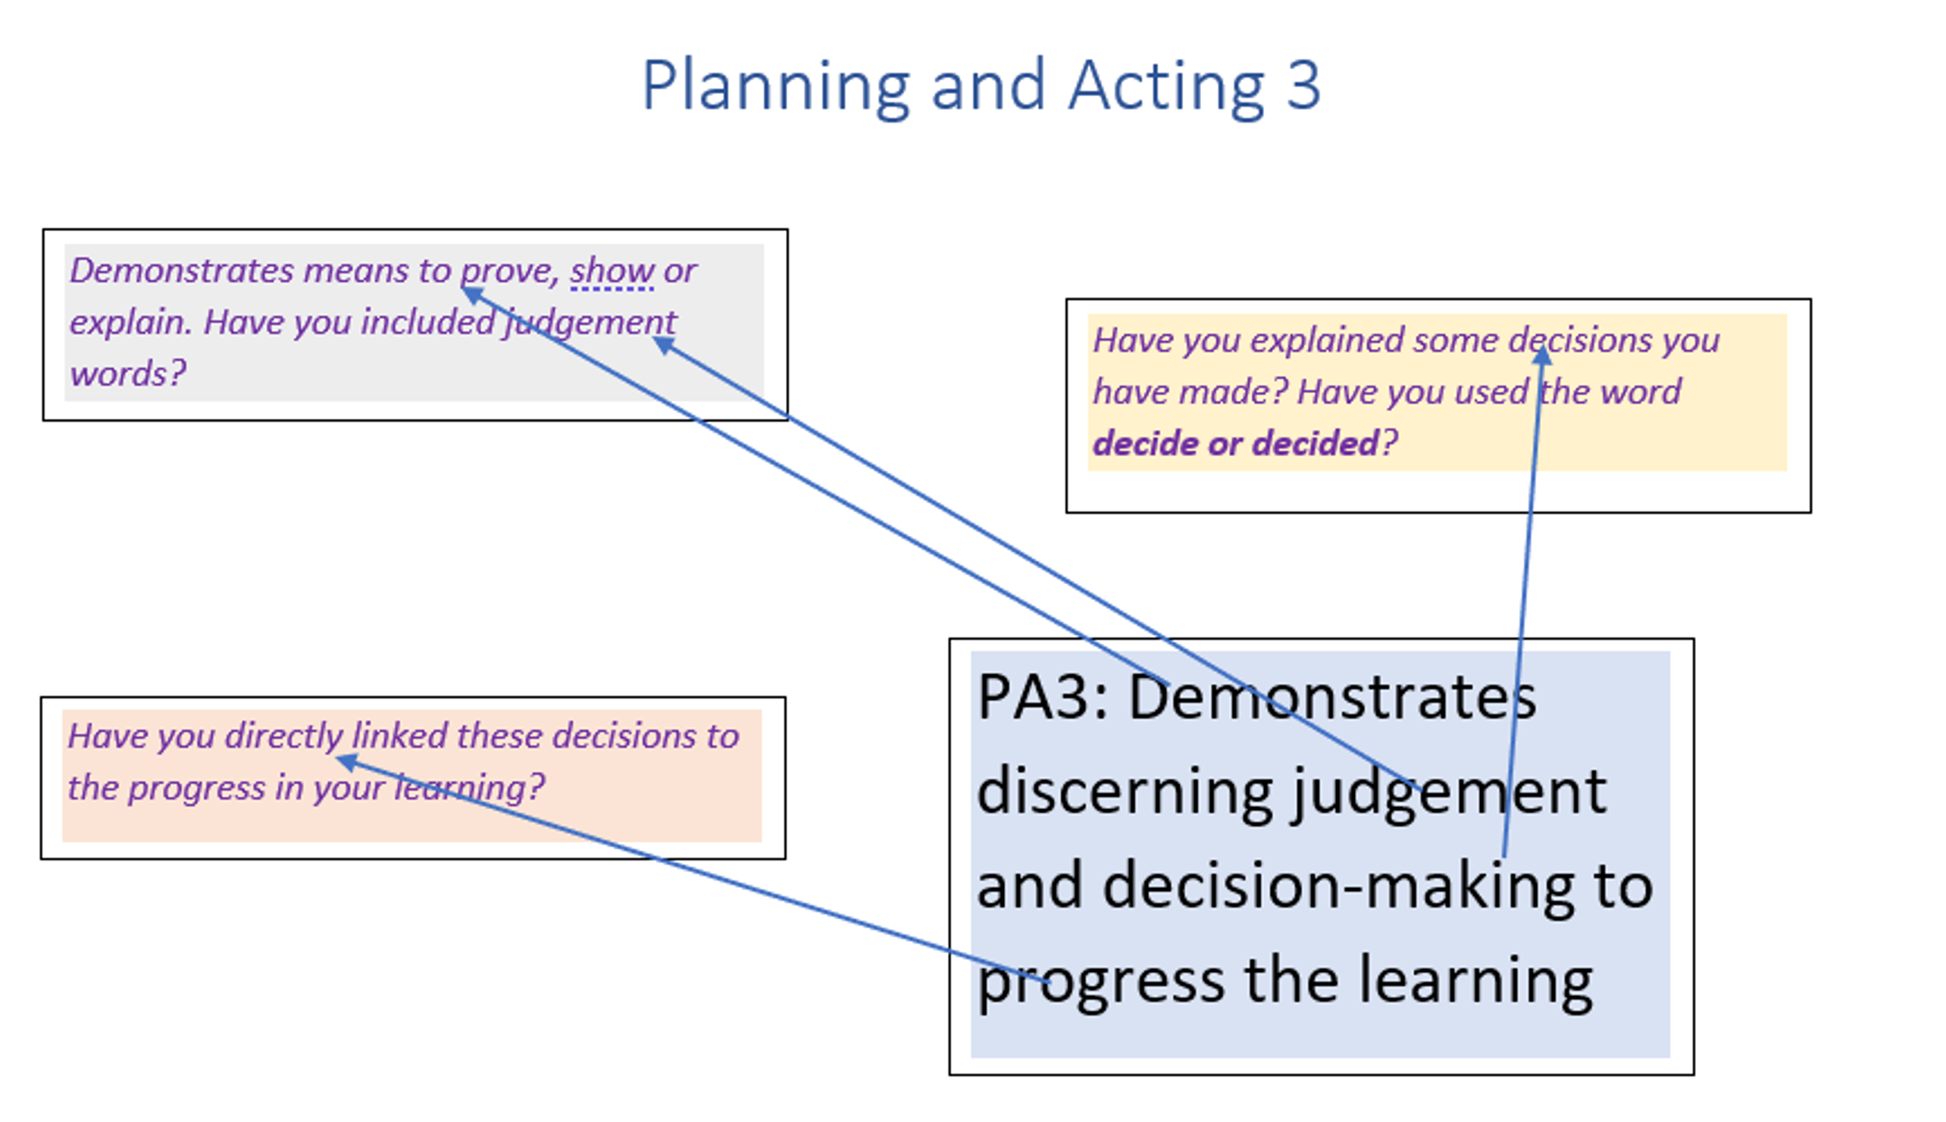
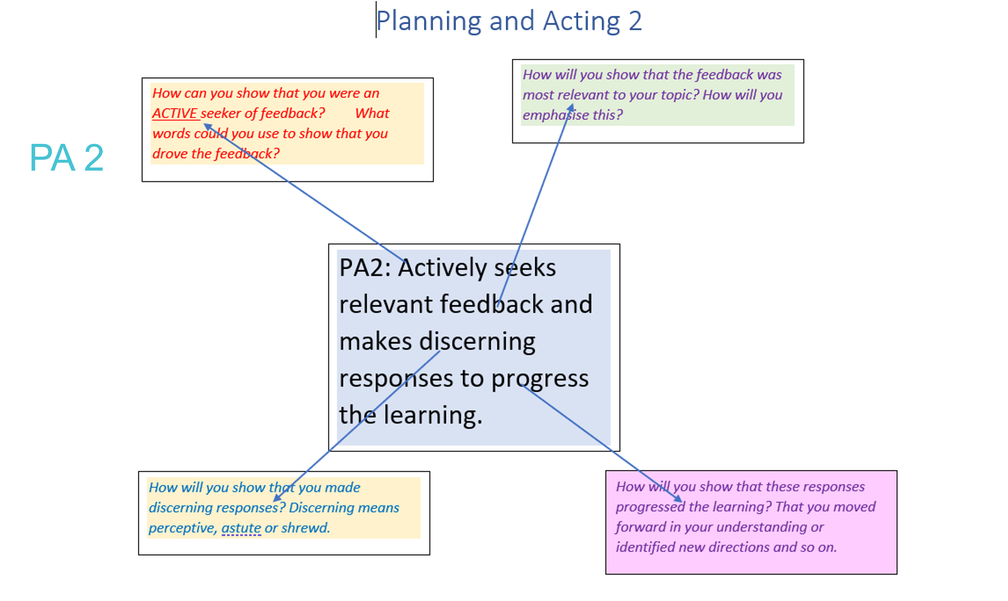
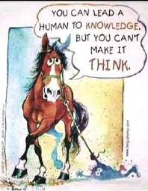
The Faciliation of Portfolio…
Develop class language and brainstorms of ideas and actions
Review and refine strategies collectively at the broad level
Teach the underpinning concepts explicitly where possible to provide the appropriate framework for student agency

Slide 23
The Faciliation of Portfolio…
Key Learnings from Pilot 1:
TIME TO FAIL!
Bumpy roads of activity and inactivity
Rigorous backend documentation – for your sanity!
Coaching Questions (ALEDA style?)
Solutions Focused Approach (based on The Miracle Question: “Assumed your problem is solved…”
Learning Mode vs. Performance Mode (Guy Claxton)

Slide 24
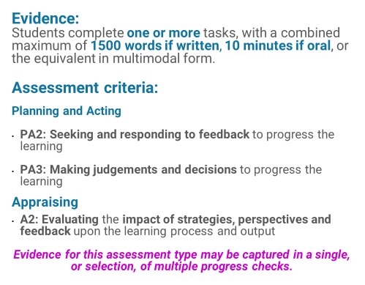
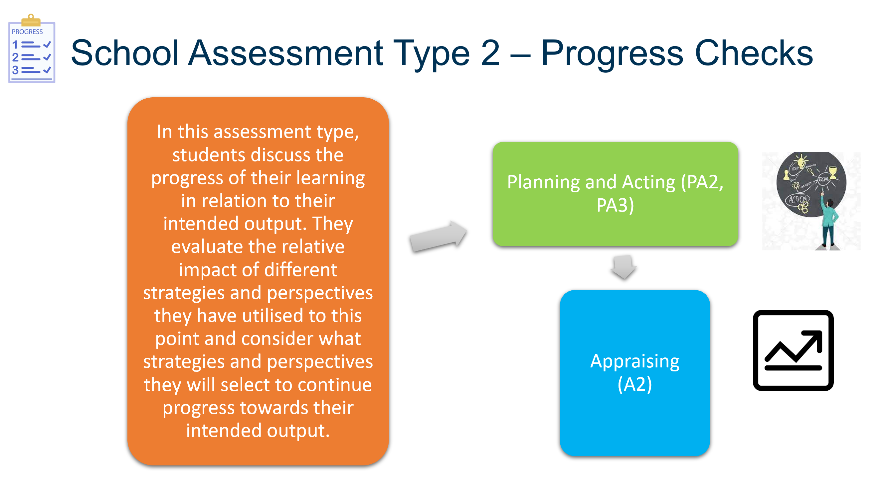
The Faciliation of Progress Checks…

Slide 25
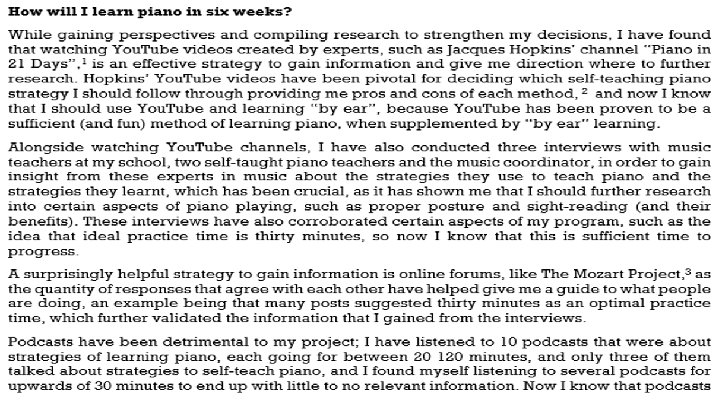
The Faciliation of Progress Checks…
Relevant
Timely
Appropriate Questions
Dynamic Formats

Slide 26

The Faciliation of Progress Checks…
Relevant
Timely
Appropriate Questions
Dynamic Formats

Slide 27

The Faciliation of Progress Checks…
Recorded conversations
I have typed these up for this presentation for clarity and to be succinct…

Slide 28
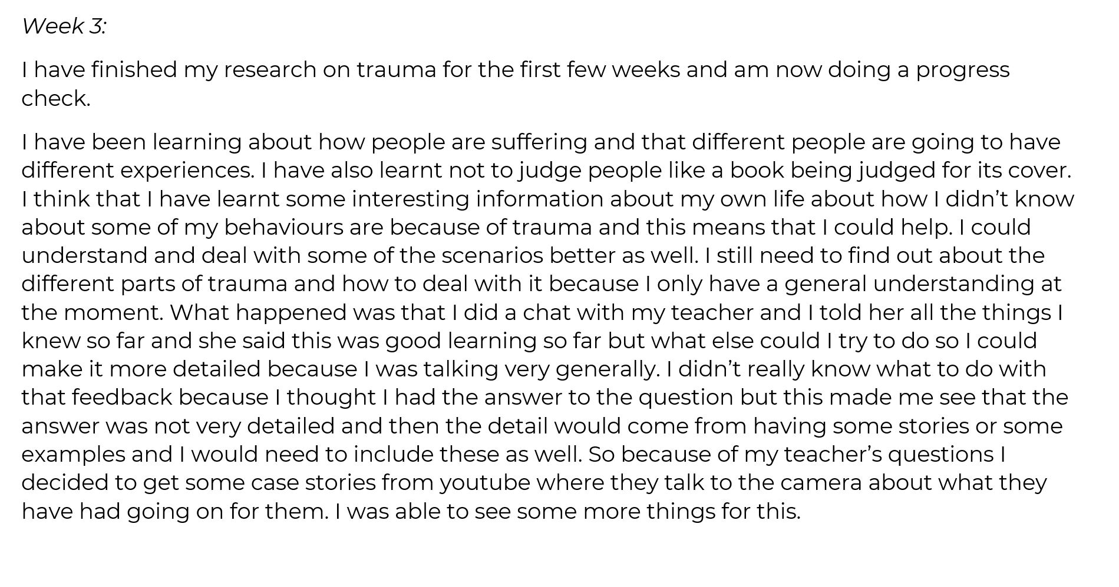
The Faciliation of Progress Checks…
Recorded conversations
I have typed these up for this presentation for clarity and to be succinct…

Slide 29
What level of agency do we see here? How sophisticated is this student’s metacognitive behaviour? How are they regulating themselves and their learning?

Slide 32
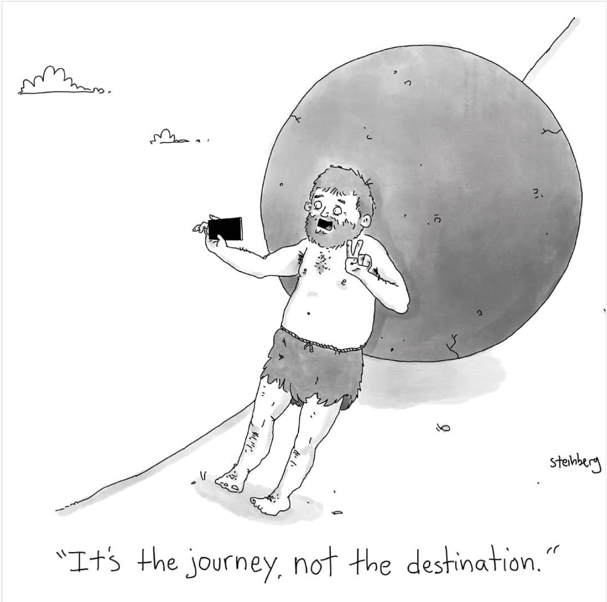
In Summary…
Hands off doesn’t mean that the teacher has left the classroom!
Our role is to assist students to understand the framework through which they can grow in their learning
Explicit teaching of skills and raising awareness of key concepts will provide framework
Students who are more successful are active in their learning - they take risks, engage with stakeholders. Fail and learn! Embrace challenge!
Go beyond! Activate that ‘IF’
More successful v. less successful
Coaching & Facilitation essentials
More to come in upcoming PDs – join our Facebook and become a member!

