Slide 1
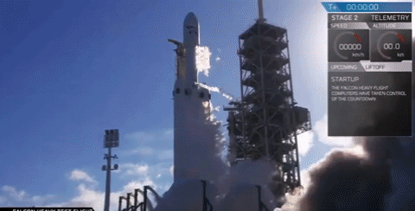
Launch into the Power of Google

Slide 2

Create and share learning intentions and expectations ...
Shared Slideshow updated week by week.
Editable or just viewable.
Incorporate gif files for impact
Over the RP programme became a 36 page document with links & expectations.

Slide 3

Session 2 Week 4 T3
Activities
Submitting in the Lab form LINK (if nec)
What you should already have:
  Refinement page
  Proposal page
  Source analysis page (RP5/SIP3)
What you need to be working on:
  Methodologies page + draft survey/interview/experimentation.
Learning intentions:
Students should be finished with 3 pages of their folio and working on their methodologies/ research development pages. For Checkpoint 2 on Monday

Slide 4
Using Google Forms
Free
Customisable
Distribution via link or email
No limit on responses
8 question formats
Will prepare some simple graphs of results
All results accessible via spreadsheet.

Slide 5
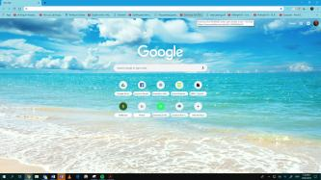
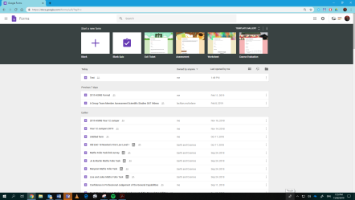
Using Forms
It all starts here
Scroll down until you find forms.

Slide 6

Using Docs and Slides to work collaboratively.
Presentation of initial ideas for panel critique
Students prepare Slides and submit the link via a Google Form.
Facilitates quick changeover of presentation
        Reduces risk of virus spread
        Allows teacher to ensure all students have submitted prior to session.

Slide 7
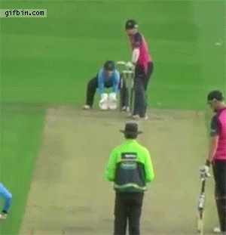
Google has got better
Font limitations …...now there are 1200+ fonts available
Drop shadows and reflections can be added
Add ons facilitate math and music notation
Ease of incorporating Youtube video links and gifs (insert image via URL) into presentations.
Unlock the power of add-ons - reference manager, voice comments
Use headings to create table of contents as in Word.

Slide 8

How to Doctopus
D
http://bit.do/asrtdoctopus
Access to a PDF of the step by step instructions.

Slide 9
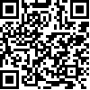
Link to materials
http://bit.do/asrtgooglepres

