Slide 1
PRE-LOAD the OUTCOME
Have your more of your students more ready …. ….for when they get there!
Key pedagogy you can deliver to support all Outcome modes.

Slide 2
Why Pre-LOAD?
“Out-of-reach” when the student gets there.
“PRE-LOAD”

Slide 3
- “SHAPES”
- PRE-LOAD POINTS
- INTRO the gift that keeps giving
- OTHER – Modes
- Materials
CONTENTS

Slide 4
SHAPES – a “pedagogical thread”
Clear and Confirming
Mixed
Merely supportive
Inconclusive

Slide 5
Pre-LOAD points
½ way through Folio
Submission of (80%) Folio
Day 1 of Outcome (Intro)
“PRE-LOAD”

Slide 6
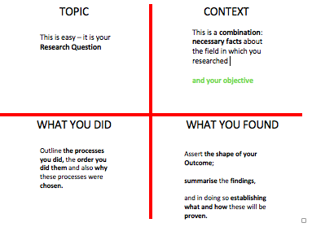
THE INTRODUCTION - the gift that keeps giving.

Slide 7
Three MODE Points (pre-load)
Question Decision
Candidate Profile
Findings
MODES

Slide 8
- “
PRODUCTIVITY – YOURS!!!
Friday 30th May | Friday 28th June | Friday 9th August | Friday 30th August
ESProgress #3 Justified revision of Action items following Progress Appraisal. | ESProgress #4 Best Selection of evidence and records from research journey is submitted | ESProgress #5 Fully referenced Draft Outcome Submitted | ESProgress #6 All final Research Folio evidence and completed Outcome submitted

Slide 9
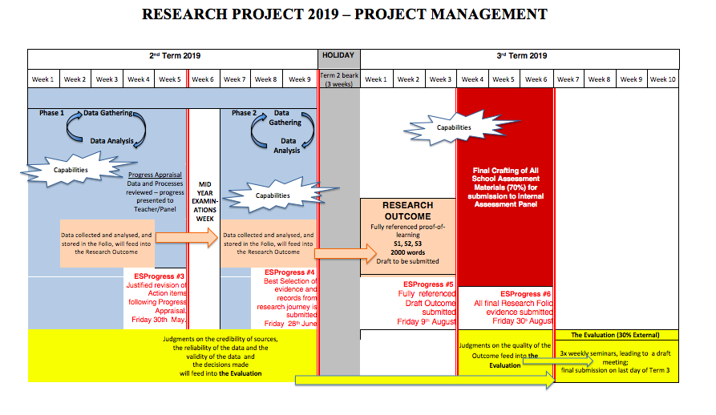
- “
MODES

