Slide 1
\\
ASRT: 2019
CAPABILITIES…
meaningful engagement
traceydorian@shc.sa.edu.au

Slide 2
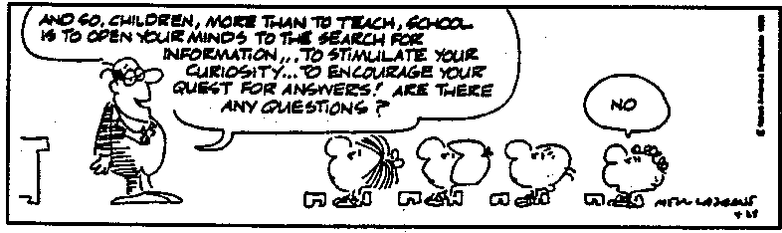
Notes:
Theoretical Ethics
Applied Ethics
Intro to Ethical Theory
Human Fulfilment/Happiness
Natural Law
Situation Ethics
Care Ethics
War, Peace and Justice
Euthanasia
Social Responsibility
Human Rights
Kantian Ethics
Political Philosophy
Theories of an Afterlife
Justice & Fairness
Freewill and Determinism
Animal Rights
Abortion
The Right to Life
Censorship in Science
Utilitarianism
The Golden Rule
Absolute and relative
morality
Emotivism
Virtue Ethics
Business Ethics
Sports Ethics
Environmental Ethics
Sex and Relationships

Slide 3
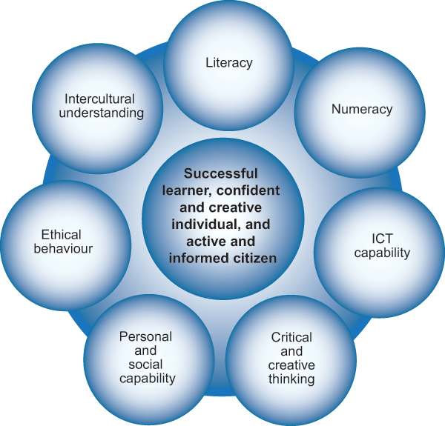

Slide 4
Students who are successful are able to demonstrate that their chosen capability/ies, are able to provide a lens through which to provide depth and an element of complexity to the research being undertaken.’
2019 SUBJECT ASSESSMENT ADVICE

Slide 5
D4: SUCCESSFUL STUDENTS...
used the capability as a lens through which the entire research was conducted and viewed
the capability was constantly referred back to and became an intrinsic component of the research.
provided explicit evidence of the development of the capability; ·
indicated both an ‘understanding’ and a ‘development’ of their chosen capability or capabilities; both must be addressed
examined only one capability; lead to a stronger series of insights, concerning the growth of knowledge and understanding in relation to the capability.

Slide 6
D4: LESS SUCCESSFUL STUDENTS...
provided token, generic, brief, superficial statements; little real evidence of growth in awareness of the nature of the capability and its contribution to the development of the research.
the capabilities were only evident in the proposal, making it difficult to demonstrate development of either the capabilities or the student’s understanding.
attempted to respond to all of the capabilities and subsequently not displaying any awareness of the scope for the capabilities

Slide 7
HOW DO WE GET STUDENTS
TO ENGAGE WITH THE NATURE OF THE CAPABILITY AND MAKE IT REAL FOR THEM??

Slide 8

IT STARTS WITH THE PROPOSAL
… and not making generic statements
PERSONAL AND SOCIAL:
As I will be using the answer of this question and research to benefit my own life, I have chosen to focus on the personal and social. This will allow me to develop a better understanding of how I can improve myself inside and outside of school and also how to help the wider community.
LITERACY:
I hope to develop my confidence in speaking to an expert in the field and be able to have a conversation where I can clarify any misunderstandings; this will help me when I go on to tertiary studies.

Slide 9
Make it real in the proposal…
Personal and social
What knowledge/skills do you want to gain?
Who do you want to share this knowledge with...why should anyone else (community / society) care?
Each one of these has to be a very specific sentence and MUST contain subject specific vocabulary...

Slide 10
What are the physiological effects of
static and dynamic stretching and how do they impact
performance in elite racewalkers?
Various forms of stretching (static or dynamic) are performed by athletes daily, but most often without a proper understanding of how to effectively apply them, and why. This applies to me as I currently do not have a full understanding of how to properly stretch during my warm up, cool down and in between sessions (static or dynamic) and the physiology behind why it is even important.
I want to share this knowledge with the wider athletics community as many athletes simply complete, without question, the stretching routines given to them by their coach, who may not necessarily have researched the topic themselves.

Slide 11
I want to gain more understanding on different types of tyres and different types of lift kits and why they can improve performance. I also want to gain knowledge about how to use gears for optimal performance and a better understanding about more car parts, such as the effective use of safari snorkels. I want to do this because this means I can give my car the best I can and get the most out of power and torque so that performance wise, my vehicle achieves what it was made to do.
What are the essential components of a 4x4 vehicle and how do they and can they enhance the off performance of the vehicle?

Slide 12
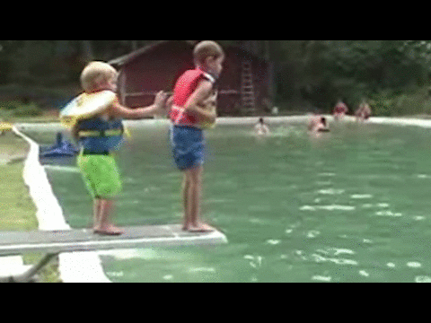
SO LET’S DIVE IN….THE 7 CAPABILITIES

Slide 13
CRITICAL AND CREATIVE THINKING

Slide 14
CRITICAL AND CREATIVE THINKING
WORKS WELL WITH:
PRACTICAL BASED: DESIGN / ART / CARPENTRY / BUILDING….
ENTREPRENEURIAL
CRITIQUING/EVALUATING ONE THING IN ORDER TO CREATE SOMETHING ELSE
IT IS NOT...I am going to be thinking!! We are hoping that everyone in the State will be doing that.

Slide 15
HOW CAN I BUILD AN ACOUSTIC GUITAR TO SUIT THE FEMALE FRAME?
CRITICAL THINKING
-Dimensions of a guitar: have they always been the same and do they suit the male frame more than the female?
- Would the sound quality be the same if the dimensions were changed?
- Can a redesigned guitar accommodate all females especially variances in female form?
- How many female artists consider the mainstream guitar as having a design fault; if so, why has no-one addressed it?
CREATIVE THINKING
- By experimenting with the design of a guitar how much of the following could actually be modified:
Neck: due to female size of hands?
Body: due to chest / lap dimensions
- By changing the materials used to make an acoustic guitar, could lighter materials be used to make it easier to hold...impact on sound quality?

Slide 16
HOW CAN HYDROPONICS ASSIST IN FOOD PRODUCTION IN DEVELOPING NATIONS?
CRITICAL THINKING
What is already being used in contemporary hydroculture systems; how effective is it especially in developing nations where resources may be limited
Effects of different bacterias and how these can be used to foster plant growth
CREATIVE THINKING
What system designs can I use that could take best advantage of vertical hydroponics rather than more traditional systems like NFT or Ebb and Flow systems
Instead of hard plastics, what other mediums can be used (acrylics, etc) and how can grey water be used if water is an issue

Slide 17
INTERCULTURAL UNDERSTANDING

Slide 18
INTERCULTURAL UNDERSTANDING
It’s all about sensitivity and respect...an awareness of the rights of individuals, culture, belief systems, ways of thinking...and the inherent complexities that are often associated when living within community...and from that a greater enlightenment about our own beliefs, etc...it is the shared story...and the growth of awareness that makes us agents for change...thereby fostering a richer community!

Slide 19
How are muslim women portrayed in Western media?
analyse the uniqueness of the Muslim religion due to their community, traditions, values and beliefs; hopefully lead to a deeper understanding of my own beliefs which stem from a Christian upbringing
Widen my understanding of the complexity of culture and how it relates to countries, religions, genders and individuals
Improve my capacity to sympathise and understand the experiences of others; an important attribute to have in a culturally diverse society and future
Encourage acceptance and understanding towards not only Muslim women, but also Muslims worldwide and the religion of Islam itself

Slide 20
ETHICAL UNDERSTANDING

Slide 21
ETHICAL UNDERSTANDING
CARING THINKING!!!
When working/engaging/interviewing others:
consensual...no coercion or inducement
no physical or emotional harm
voluntary involvement and individuals have the right to discontinue
Besides bias...every student should address accuracy of information:
integrity and rigour; authenticity of data
no false or misleading results
limitations and shortcomings acknowledged
Focus (and it means being sensitive and aware)
legal / environmental / workplace / cultural…

Slide 22
TO WHAT EXTENT CAN INDUCED PLURIPOTENT STEM (IPS) CELL-BASED THERAPY BE USED TO TREAT SPINAL CORD INJURY?
I have a great interest in the potential applications of IPS cells and the ethical understanding capability will enable me to gain a greater awareness about scientifically what is happening in stem cell research and why it is still considered to be a contentious issue. I want to know how iPS cells can be used to treat spinal cord injury and what the positive and negative impacts iPS cell therapy may pose, as well as what they can be used for in medical research and drug testing. Ethically, I need to be very sensitive that I am consistently considering both sides of the argument. The community should care about stem cell research as it has potential to treat and cure diseases such as Alzheimer’s, diabetes, Parkinson’s and spinal cord injuries, but from initial research our ethical thinking should also have us considering how the use of IPS therapy may be disadvantageous; nothing is ever that black and white.

Slide 23
NUMERACY

Slide 24
NUMERACY
Like literacy...it is using language but it’s mathematical language...and it is being used to analyse information and share information
The numeracy lens allows students to:
solve problems
make estimations and predictions
design and create
collate and interpret data
provide reliable evidence that is accurate
For students who are engaging in any form of mathematical work...where it is the driving force, they are focusing on how numeracy is playing a significant part in providing a resolution to the question.

Slide 25
TO WHAT EXTENT CAN MATHEMATICAL MODELS OF CLIMATE PREDICT FUTURE CLIMATE?
Through my research I hope to learn more about the correct terminology used for climate and mathematical models, hence making it easier to convey my ideas to potential interview participants and in my research outcome. Additionally, I plan to develop my interpretation skills through comparative analysis of statistics of physical observations and forecasted climate and hence also develop my numerical justification abilities when making statements in regard to empirical information. Furthermore, when it comes to formulating my conclusions I hope to justify key ideas by incorporating statistical evidence in conjunction to my researched reasoning.

Slide 26


Slide 27
INFORMATION AND COMMUNICATION TECHNOLOGY

Slide 28
INFORMATION AND COMMUNICATION TECHNOLOGY
It is all about the use of ICT in our world...the good, the bad, the interesting...and students being critically aware of HOW it is being used in our society (the impact and its potential).
Cyberbullying
Impact of social media in advertising...
This is a great capability where students can focus on the skill they are developing by using ICT:
software programmes and applications
hardware components
designing and planning
transmission and production of information
·

Slide 29
HOW IMPORTANT ARE PROGRAMMING LANGUAGES IN THE GAME INDUSTRY?
Initially I am going to be critically evaluating successful games that are intricately designed but more importantly developing the skill required to be able to programme a game with a computer language that is industry standard. I am very aware that gaming is a huge industry and its breadth and depth of games range from being quite innocent and fun to dark and destructive; I will be consciously just focusing on the intricacies with computer languages such as those in Code Academy: HTML and Javascript. I hope that being a part of the gaming industry is a part of my future, and I want this Research Project to be the beginning of always being conscious of the role of a creator when entertaining others….the use of ICT is at the heart of this.

Slide 30
LITERACY

Slide 31
LITERACY
It is NOT...just reading and writing and speaking to people… EVERYONE IN THE STATE SHOULD BE DOING THAT!!!
It is:
insightfully engaging with language (and that may include creating a glossary to build knowledge)
wanting to ensure that the information gathered is accurately disseminated
it is being articulate when engaging with others...and using language precisely
EFFECTIVELY COMMUNICATING

Slide 32
A survey revealed that 1 in 4 deaf people quit their jobs due to discrimination. What is the reality of employment discrimination against deaf people in Australia?
I want to improve my awareness of how discrimination affects deaf individuals and the broader deaf community through critiquing government legislation and then exploring how it is applied by communicating with deaf people. In order to communicate effectively, I need to strengthen my sign language skills, but also extend my capacity to communicate with deaf individuals, as not all hearing impaired people, sign. It is important that in gathering information I accurately portray not only what the government is attempting to achieve by maintaining an unbiased perspective, but also become an advocate for those who are deaf and feel that they have been discriminated against. I hope to be able to clearly and articulately share an understanding of how the community can help to promote deaf equality and also increase my awareness in how discrimination can affect the careers, education, and socialisation of a deaf person.

Slide 33
PERSONAL AND SOCIAL

Slide 34
PERSONAL AND SOCIAL
An awareness that the student has their own identity and goals and can actively participate and engage in their own life and community
Students are developing knowledge and skills...they are researchers...and their findings do have an impact on their community
Basically...are students thinking about their place in the world...they are no longer passive absorbers of information...they have rights and responsibilities

Slide 35
HOW CAN A FREE-DIVER ENHANCE THEIR LUNG CAPACITY?
PERSONAL
- understand how to maximise my diving response and increase lung capacity
- increase skill capacity of being mentally focused in order to manage diaphragm contractions, etc
- network with other free-divers/learn from their experience in order to design a safe and effective programme
SOCIAL
- ensure that safe practices are being upheld & communicated amongst individuals interested in free-diving (particularly surfers)
- to be an advocate for the sport and assist in raising its profile
- pass on my knowledge of this dive response so as to provide valid and reliable information to others via online forums, etc

Slide 36
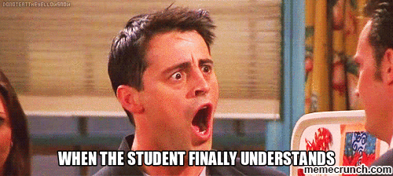

Slide 37
AND WHEN DO STUDENTS WRITE ABOUT THE CAPABILITY??
WHENEVER THERE IS MEANINGFUL GROWTH AND INSIGHT PERTAINING TO DEVELOPING A RESOLUTION TO THE RESEARCH QUESTION...and hopefully should not just be tacked on at the end of a reflection or discussion
WHENEVER THERE IS A LIGHT BULB MOMENT IN RELATION TO IDEAS / CONCEPTS RAISED IN THE PROPOSAL (COULD BE IN A MAJOR CRITICAL REFLECTION)
NOT IN EVERY SINGLE REFLECTION (JOURNAL ENTRY) IN RESPONSE TO A SOURCE….
IT ENDS UP BEING REPETITIVE / GENERIC / EMPTY

Slide 38
Whenever students write about their capability,
it should show real growth in awareness of the nature and potential of the capability to help drive their investigation…
THEY ARE MORE THAN STUDENTS WHO ARE JUST DOING THE RESEARCH PROJECT…
THEY ARE RESEARCHERS AND GLOBAL CITIZENS MEANINGFULLY ENGAGING WITH THE WORLD.

Slide 39
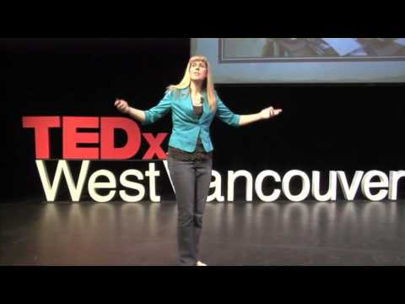

Slide 40

traceydorian@shc.sa.edu.au

