Slide 1
Research Project A
A subject for all students.

Slide 2
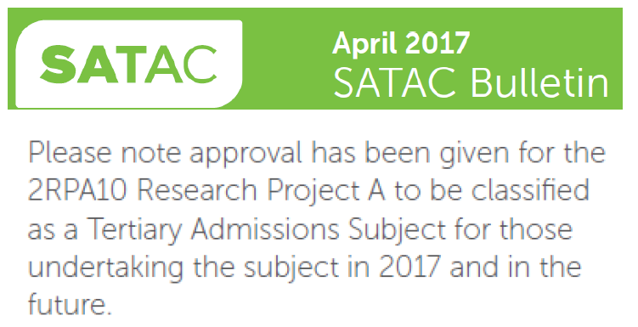

Slide 3
Current trends
9432 students undertook RPB in 2018
1465 students undertook RPA in 2018
(This is an increase of about 400 students from 2017).
Xxx students withdrawn from RPB in semester 1 and 2.

Slide 4
Myth – busting!
What do you hear about RPA?
It’s for VET students.
It’s for less able students only.
It’s where you put your RPB students at the end of the course when it doesn’t look like they’ll pass.
RPA can be so much more than this!

Slide 5
Quick reminder - What’s the difference between these two subjects?
 | RPA | RPB
Folio | 10 pages P1, P2, D1, D2, D3, D4. | 10 pages P1, P2, D1, D2, D3, D4.
Outcome | 1500 words (or 10 minutes equivalent in multi-modal). | 2000 words (or 12 minutes equivalent in multi-modal).
External | Review | Evaluation
Please note – the Review is very different to the Evaluation! – more later.

Slide 6
Who would be advantaged by doing RPA?
Students who want to do well.
Students who have a topic which is more suited to a shorter, more contained Outcome.

Slide 7
Who would be advantaged by doing RPA?
Students who have more experience in the responding style required in the external for RPA. This may mean they could score higher than they would in RPB and so improve their ATAR. (Look at the example data provided).

Slide 8
Who would be advantaged by doing RPA?
Students who might be at risk of not passing RPB (and so not getting their SACE), can undertake a subject more suitable to where they are at now and not have to perhaps give up on getting an ATAR. (Allows for increased differentiation in the classroom).

Slide 9
How can RPA be advantageous to schools?
Students may be more likely to pass RPA the first time – reducing the need to run classes in the following semester. This gives funding back to the school to reduce class sizes, create more specialist classes and so on.
RPA and B students can be all together in the one class which means classes can be more evenly balanced and so reduce cost and load.

Slide 10

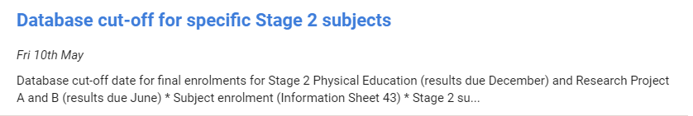
How easy is it to move between the two subjects?

Slide 11
Friday 10th of May is closing of enrolments.
Up until this time your SACE Coordinator can move students from RPB classes to RPA classes and vis versa.
After this closing date you can still move students if you need to - just add them to the new subjects results sheet once it has been generated and withdraw them from the previous subjects result sheet.
Make sure your SACE Coordinator has a class of RPA open with at least one student in it. Then you can add students to this class right up until submission and withdraw them from RPB.

Slide 12
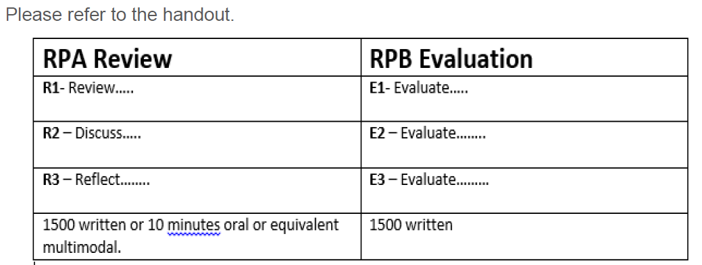
How is the RPA Review different to the RPB Evaluation?

Slide 13
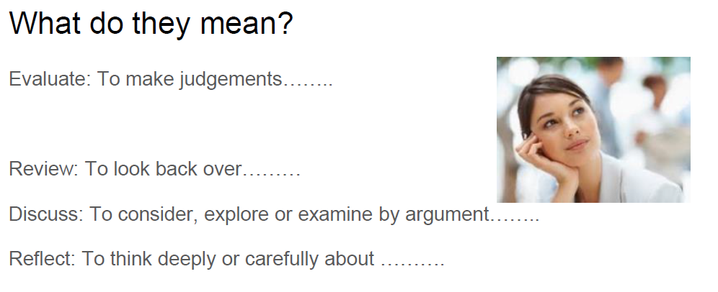
Notes:
It is important to note that this criteria is different to the evaluation criteria and students are less successful if they address the evaluation criteria - Students who submit evaluations as reviews hoping for a better grade are often disadvantaged. When you teach RPA it is important to teach to this criteria and successful students will often use headings to ensure they allocate appropriates ‘word counts’ to each section and ensure they are responding to the criteria.

Slide 14
R1 - review the knowledge and skills you have developed in response to your research question
Scaffolding Questions
What new knowledge have you learnt? How did you learn it?
What was the most significant aspect you learnt and why was it significant?
What did you know before starting your research, what did you find out along the way and how much do you know now?
What new knowledge did you gain and how did this impact your research project?
What skills did you gain and how will they continue to benefit you?
How did learning….. help you answer your research project question?
Identify and review new knowledge
Prioritising knowledge
Show how far that has been developed
differentiated between knowledge and skills
Discuss how that knowledge or skill helped them answer their research project
Use words like before, after, prior to this, became clearer, now made sense….
Don’t talk about skills and knowledge that isn’t relevant to your research question.
Don’t simply list generic skills like note-taking, reading, etc. Make them nuanced and relevant to your project.
Notes:
TO HELP STUDENTS ADDRESS THE CRITERIA, I FIND IT BENEFICIAL TO SCAFFOLD THE ASSIGNMENT WITH GUIDING QUESTIONS TO HELP THEM DISCUSS ALL THE AREAS MENTIONED.

Slide 15
R1 Example
Before I began research for my question, my initial knowledge was underdeveloped and rudimentary with only a basic understanding of the English monarchy’s involvement in, and relevance to, Australia. Through further research, my understanding of the English monarchy and its role in Australia began to grow immensely so that I gained a comprehensive and nuanced understanding of the executive, social and historical functions of the monarchy. Through interviews with such people as Dr. Steven Anderson, I obtained a further understanding of how Australia’s early history forged its loyalty to the English crown.

Slide 16
R2 - discuss the decisions you made in response to challenges and opportunities
discuss in detail the significance of decisions made
discussed both the positive and negative aspects of their decisions How did that decision influence/affect your research?
Students should avoid generic challenges such as internet being blocked, workload, teacher being away. When Teaching this section it is important to highlight what some challenges and opportunities may be and what are not.
Scaffolding questions
What was the challenge or opportunity?
What decision did you make when you encountered the challenge or opportunity?
How did that decision influence/affect your research?
Don’t simply recount generic challenges like poor time management, technical difficulties.
Don’t only focus on challenges and opportunities without discussing the decisions you made.

Slide 17
R2 Example
One of my most difficult challenges was to obtain and confirm interviews. My first decision had been to approach Dr.Paul Sendzuik, a historian from Adelaide University but he did not reply to me. My appropriate decision in response to this was to move on and to find new people to interview in the same field. As such, I made the choice to ask Dr. Steven Anderson, who is also a historian at Adelaide University, for an interview. This was a good decision because he proved to be the most influential and helpful person towards validating my key findings in the second part of my outcome. He was particularly helpful in his expertise in the history of Australia’s relationship with the monarchy. Therefore, the decision to persevere in contacting an historian effectively shaped this entire section of my outcome for the better, as Anderson was a historian of Australian History who provided very reliable information.

Slide 18
R3 - reflect on the quality of your Research Outcome
Scaffolding questions
Reflects on successes and limitations of the research outcome
Reflected on the quality of their Research Outcome
Discussed the significance of their findings and the features that influenced the overall value and worth of their Research Outcome
Reflected on the extent to which the question has been answered.
Assessed the suitability of the research outcome format in relation to the question and their target audience.
What was the strengths of your outcome?
What were the weaknesses?
How well did your outcome answer your question?
How did the outcome target the audience?
How did the outcome benefit you/others?
Use words like quality, value, worth, significance, importance of, reliability, strengths, limitations

Slide 19
R3 Example
Despite many strengths in the answer of my question, there were also limitations because of the reliance on opinionative data that shaped this research. As such, I believe that the quality of my outcome was still very good because it contained a variety of information about the relevance of the monarchy to Australia, which made for interesting reading. The argument presented was cohesive and well documented. The substantiation of the argument was completed to a high standard as I included statistical data, historical perspectives, and points of view from primary sources, as well as from current media articles. This gave the reader a wide range of viewpoints that were well substantiated, so my findings were credible and valid. The clarity of the answer was improved by sectioning findings into focus areas which allowed for a fuller discussion of each point. This allowed for a more objective response to this highly opinionative issue by allowing for contrasting levels of relevance to be explored.

Slide 20
S3 - organise your information coherently and communicate ideas accurately and appropriately.
Expression should be fluent and ideas are well organised
Headings that related directly to the 2019 subject outline and so served to organise the review, aiding clarity.
Students should use a range of vocabulary, including varied qualifiers.
Work should be carefully drafted and edited to ensure effective communication.
Make good use of the summary!!!!!! It also contributes to S3 and can help to ‘put the marker in the picture’.

Slide 21
Example summary
Summary
My research project was driven by my fascination with the Imperial ages of countries during the 18th and 19th century, especially the development of British Empire. My early reading led me to devise my final question “To what extent is the English Monarchy a relevant institution for Australia? Interviews were conducted with several experts in History and Politics including; Dr. Steven Anderson, lecturer in 19th century Australian history; Luke Mansillo, PhD graduate in Government and International Relations and Mr. Ben Rillo, Political advisor and member for the SA committee for a Republic. By conducting these interviews, I was able to establish key findings such as how the monarchy’s popularity in Australia has risen greatly in recent times. Also, it was found that the Queen’s link with Australia is a formal one only, because constitutionally she has no real powers in Australian governance. My outcome was presented as a formal written report.

Slide 22
Tips and Advice
Notes:
To sum up,
As teachers you can help students by getting them to use headings despite how they chose to present their review. Ensuring they are addressing the criteria and not using their word count or time to discuss irrelevant processes or recount what they did throughout their whole research project.
Providing students with questions to answer and scaffolds can help them to appropriately address the criteria.
Students should avoid
Providing a recount, ignoring criteria, not addressing each criteria enough.
It’s important to note that students are able to be quite successful in RPA and that even though students may be capable of RPB, the RPA criteria may suit them more and therefore allow them to be more successful. Last year in particular, there was a higher standard of reviews produced because teachers realised this and also because it now counting towards the atar.

Slide 23
From my experience only – all students and sites are different.
My students who have little experience of producing a volume of work find the folio onerous. This can be overcome by-
Setting it out for them page by page – they will only do 10 pages! Scaffold the pages so all criteria are covered.
Using their phone to tape conversations between us which can then be transcribed – even with ESO help.
Using the phone to record material such as secondary source analyses after watching TED talks and so on.
Making use of the staff in the school for interviews and expert assistance.
Recording their Review orally.

Slide 24
Others experiences?

Slide 25
Chief assessors report – issues with the Review.
As has been identified in previous years, many students are presenting their Review for RPA, in a manner designed to meet the specific features of the Evaluation in RPB. This limits their success, as does a discussion of outdated specific features (such as the capabilities developed).
Other students were hampered because they provided a recount of their research project as a whole in R1, rather than focusing on the new skills and knowledge they developed e.g. “First I completed a lotus diagram, then I started to look through the Internet”
Only briefly discussed new knowledge developed and then focused on generic skill development such as searching the internet.
Used the majority of the word-count in addressing specific feature R1 (review of knowledge and skills), often giving only cursory treatment to R2 and R3. In some cases, R3 was not addressed at all

Slide 26
Chief assessors report – issues with the Review.
Less successful students –
devoted much of the discussion to an explanation of the challenges and/or opportunities themselves, rather than the decisions made. A significant number of reviews omitted any mention of decisions at all.
made reference to superficial issues of time management/being disorganised/Internet not working/sites being blocked/missing school. Generally, a generic and superficial response to these ‘challenges’ was produced.

Slide 27
Chief assessors report – issues with the Review.
The less successful responses –
reviewed their Research Project, particularly how they conducted their research rather than focusing on their Research Outcome and how they were able to provide a resolution to their research question.
made simplistic or exaggerated comments about the quality of the Research Outcome, including a sole focus on how it was personally meaningful

