Slide 1
Research Project
- a beginner’s guide
Simon Sharley & Tara baron

Slide 2
Research Project
Research Management
Planning
Development
Synthesis
Evaluation/Review
SACE - (Rubric/Performance Standards)
Project Management
Overview
Order
Progress Reports
Deadlines
School Based (You are in control)

Slide 3
Week 4 is here..
What decisions have you made in relation to Project Management?
What decisions have you made in relation to Research Management?

Slide 4
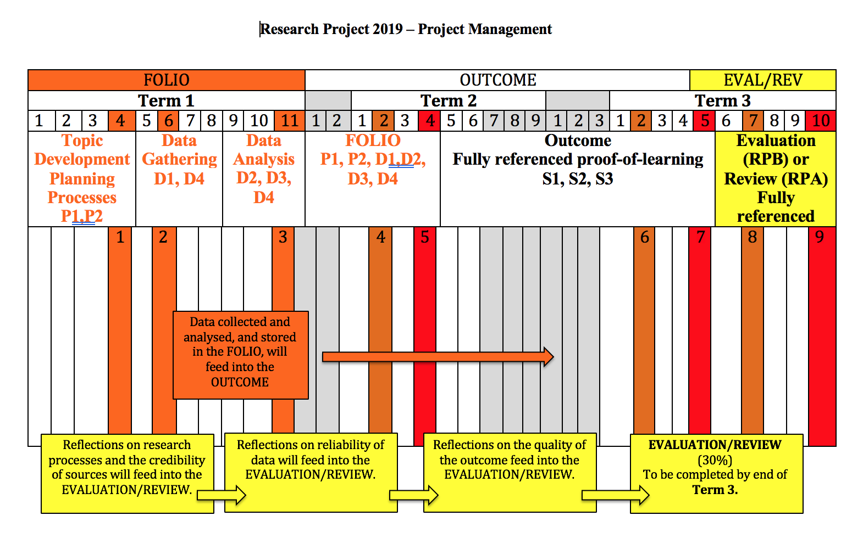

Slide 5
Research Management:
Deciding on a Topic
Recording Key Individual Moments

Slide 6
their Project, not Yours..
Teachers…
Students should consider their;
  Interest Areas..
  Career pathways..
  Enjoyed Subjects..
  Hobbies outside of school..
  Current Media..
  Social Trends..

Slide 7
Pre-knowledge in a Topic can be advantageous
In understanding concepts, terminology, interest areas, passions….
but more knowing what is not known.

Slide 8

Topic Consideration – Build the evidence
Drilling Down
Why?
Why?
Why?
‘beginning to unearth their research objective’
Who will benefit?
Who is the topic important for?
Why is there a need for this?

Slide 9
Checking IN
A Must Do.. Regular.. Planned.. Unplanned..
Questions can/need to change/refine/alter direction later but strong topic consideration prevents large false starts.

Slide 10
Refinement of Question
Try, try, try again

Slide 11
Effective Questions:
- Allow for in depth research
- Allow for academic, personal and/or intellectual rigor
- Extend the student
- lends themselves to a position on the topic

Slide 12
Annotations
Getting the most out of the source

Slide 13
Justify your choice
Why was this source chosen??
Is it credible?
- Is it relevant?
- Is there new information?
- Is it coming from an appropriate search engine?

Slide 14
Deconstruct
Read, view, listen – again and again and once more…
3 Key Ideas
Origins of source
- who is responsible for publication?
- funding of publications, author stance (background etc)
- bias, credibility, reliability, validity, comparisons to other texts, where to next?

Slide 15
Make meaning
Consider:
Why is this useful to my learning and answering of question?
What does this mean for the direction of the research?
What challenges does this create for my research moving forward?

Slide 16
Consistency
Format
Language
Peer critique
Self editing – it will SAVE your sanity

Slide 17
Where to next…
Outcome – 12:15 with Chris here in the Library
Evaluation – 11:25 with Jasmine in the main Pavilion

